Slide 1

Expected utility theory examples
Notes on Behavioural Economics
Jason Collins

Slide 2
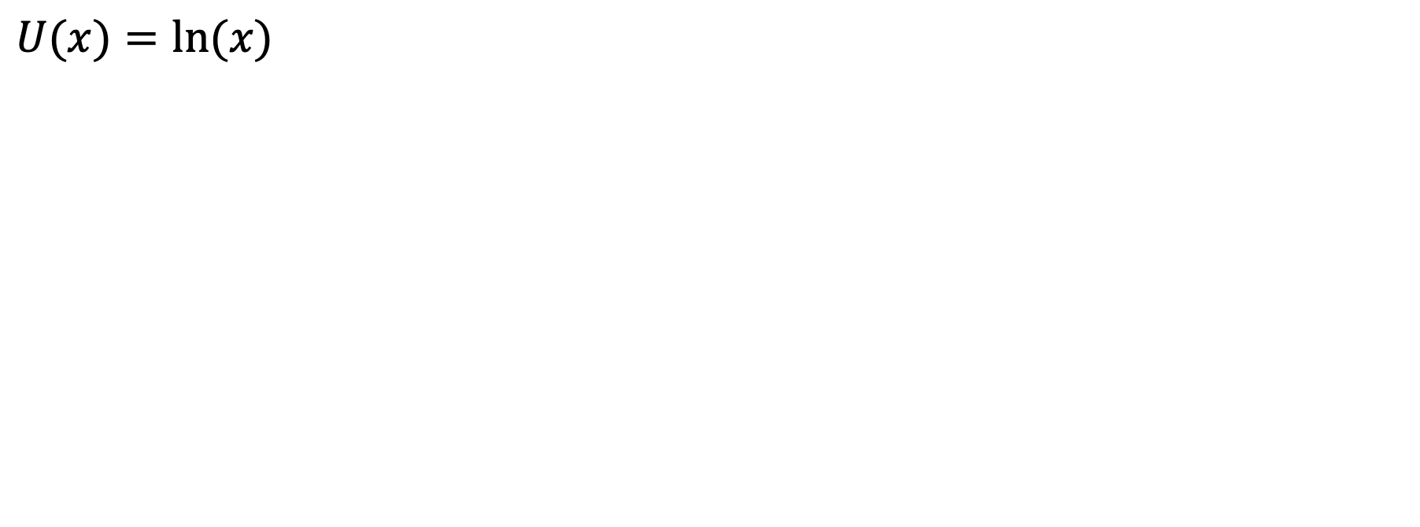
$$U(x)=ln⁡(x)$$

Slide 3
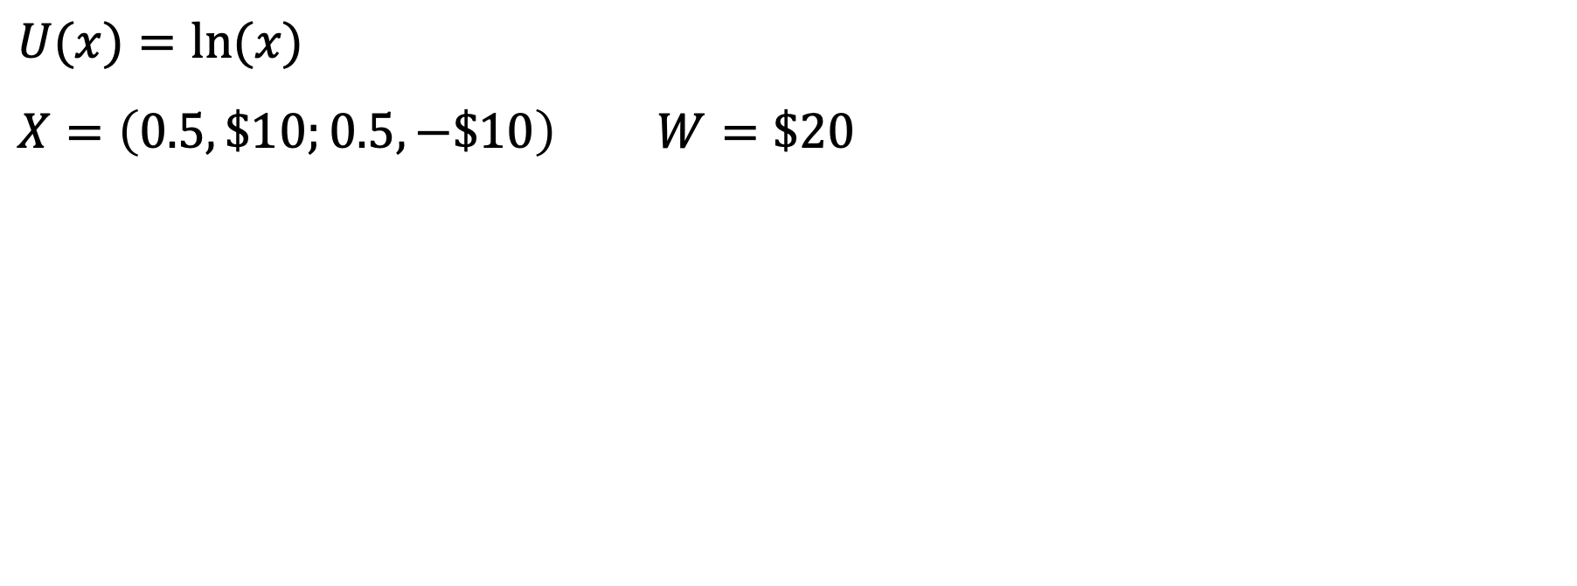
$$U(x)=ln⁡(x)$$
$$X=\left(0.5,\$10;0.5,−\$10\right) W=\$20$$

Slide 4
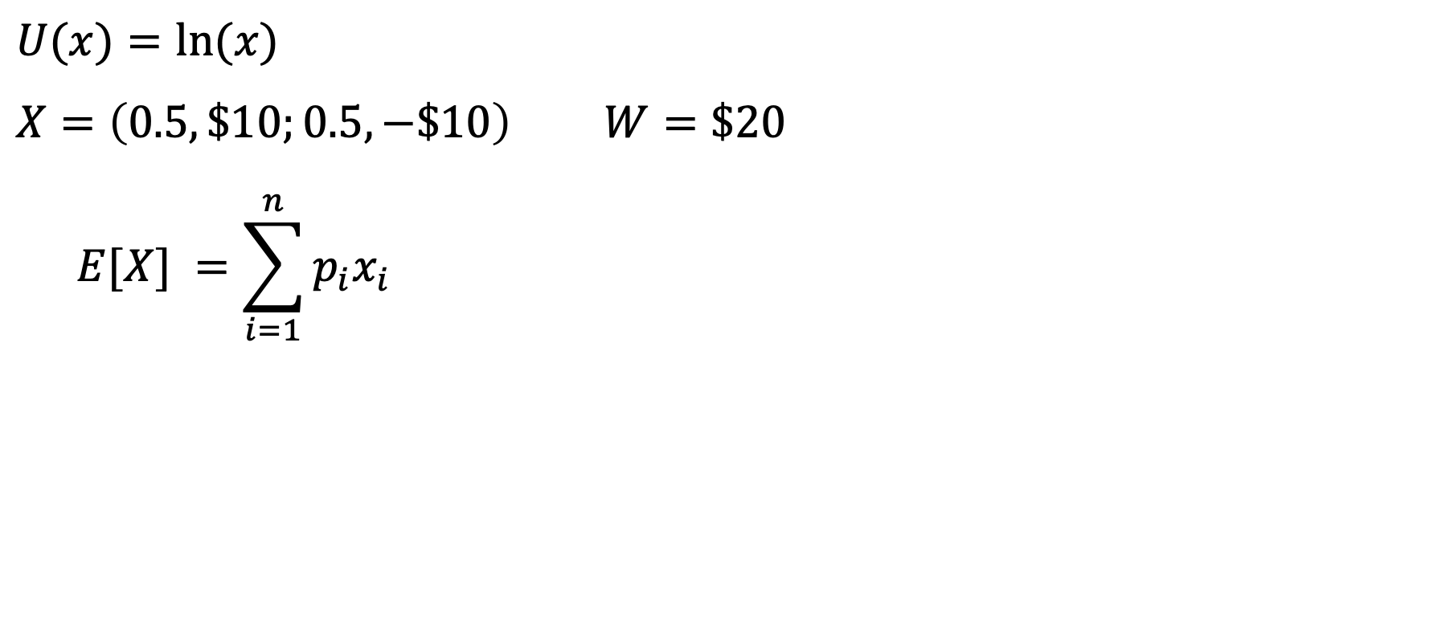
$$U(x)=ln⁡(x)$$
$$X=\left(0.5,\$10;0.5,−\$10\right) W=\$20$$
$$E[X] =\sum_{i=1}^{n}{p_{i}x_{i}}$$

Slide 5
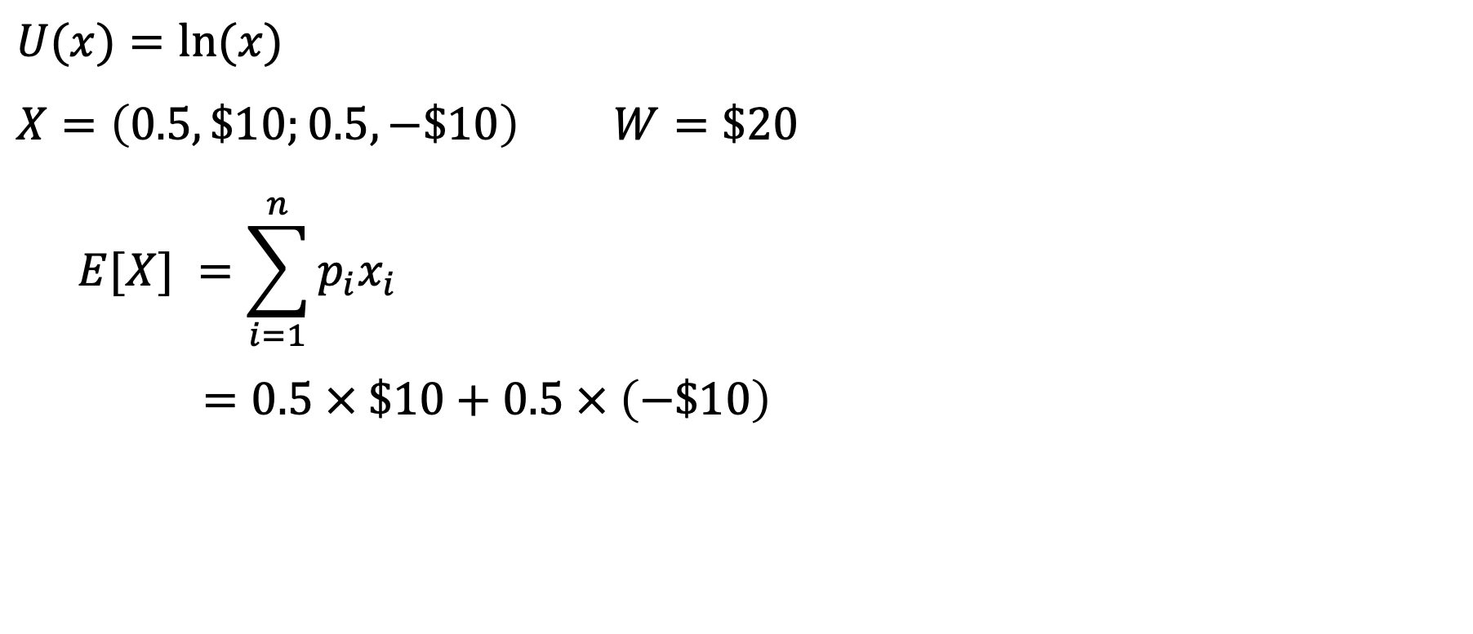
$$U(x)=ln⁡(x)$$
$$X=\left(0.5,\$10;0.5,−\$10\right) W=\$20$$
$$E[X] =\sum_{i=1}^{n}{p_{i}x_{i}}$$
$$=0.5 × \$10+0.5 × \left(−\$10\right)$$

Slide 6
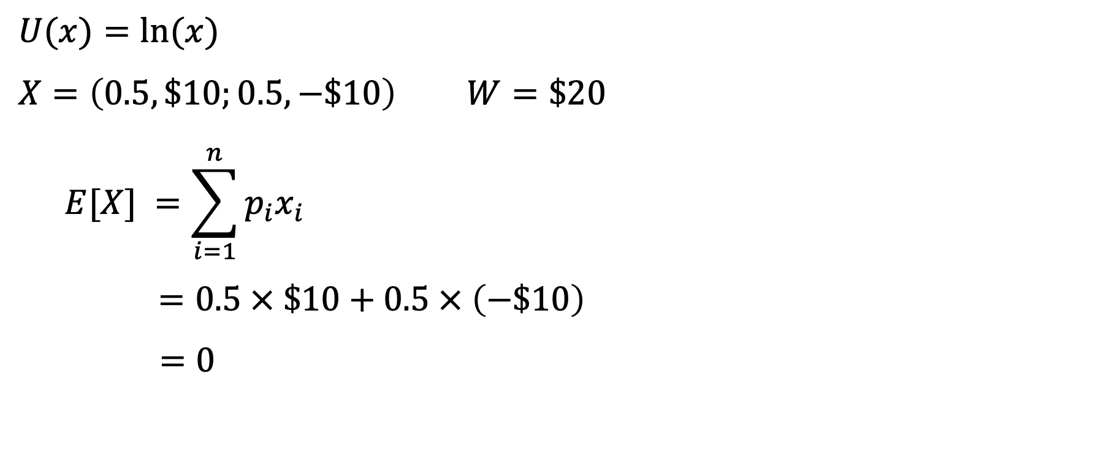
$$U(x)=ln⁡(x)$$
$$X=\left(0.5,\$10;0.5,−\$10\right) W=\$20$$
$$E[X] =\sum_{i=1}^{n}{p_{i}x_{i}}$$
$$=0.5 × \$10+0.5 × \left(−\$10\right)$$
$$=0$$

Slide 7
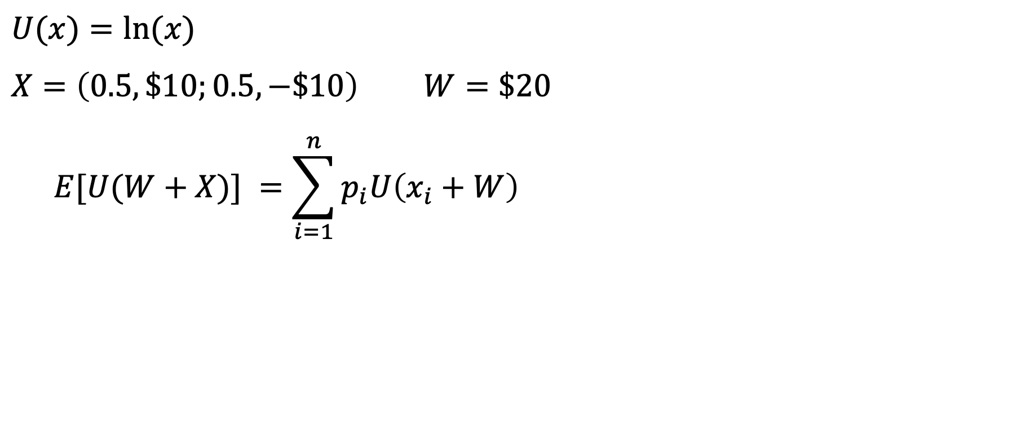
$$U(x)=ln⁡(x)$$
$$X=\left(0.5,\$10;0.5,−\$10\right) W=\$20$$
$$E[U(W+X)] =\sum_{i=1}^{n}{p_{i}U\left(x_{i}+W\right)}$$

Slide 8
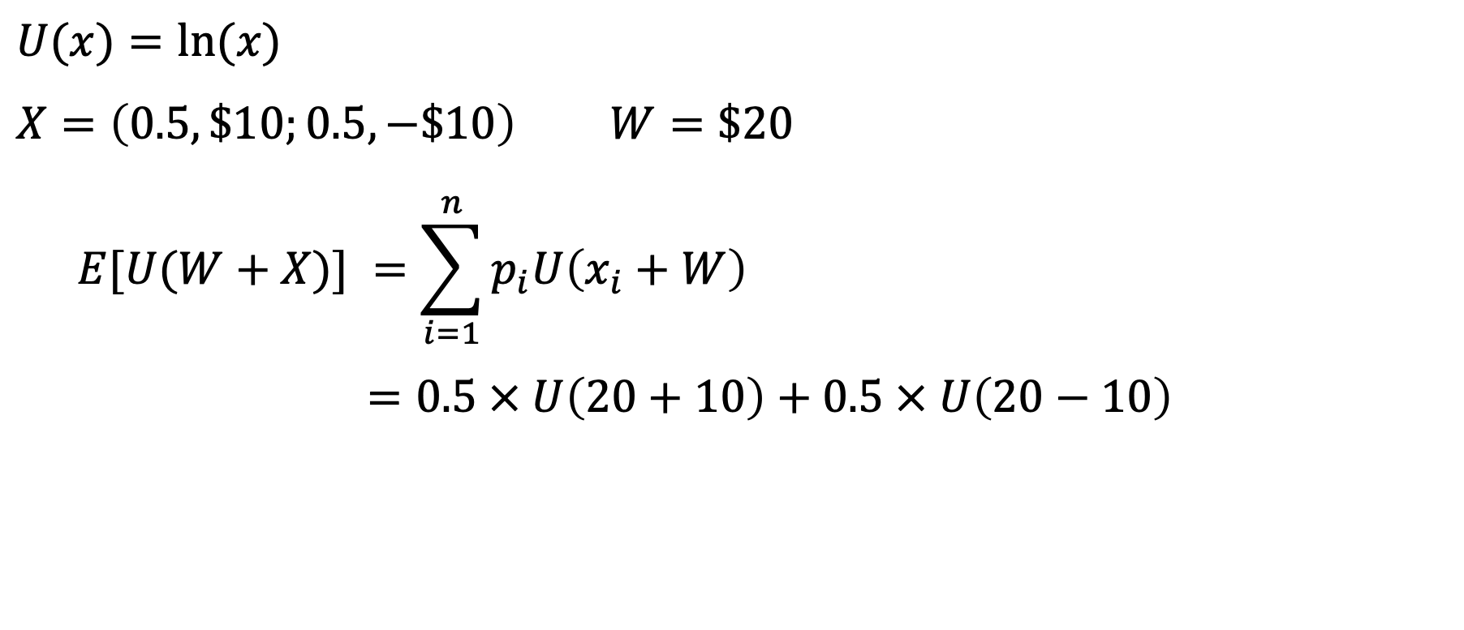
$$U(x)=ln⁡(x)$$
$$X=\left(0.5,\$10;0.5,−\$10\right) W=\$20$$
$$E[U(W+X)] =\sum_{i=1}^{n}{p_{i}U\left(x_{i}+W\right)}$$
$$=0.5 × U\left(20+10\right)+0.5 × U\left(20−10\right)$$

Slide 9
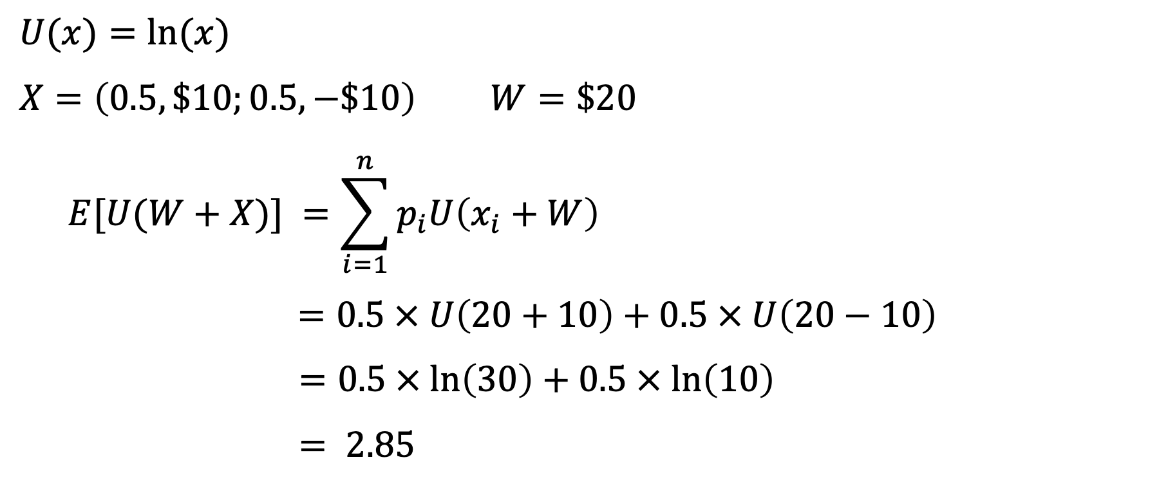
$$U(x)=ln⁡(x)$$
$$X=\left(0.5,\$10;0.5,−\$10\right) W=\$20$$
$$E[U(W+X)] =\sum_{i=1}^{n}{p_{i}U\left(x_{i}+W\right)}$$
$$=0.5 × U\left(20+10\right)+0.5 × U\left(20−10\right)$$
$$=0.5 × ln\left(30\right)+0.5 × ln\left(10\right)$$
$$= 2.85$$

Slide 10
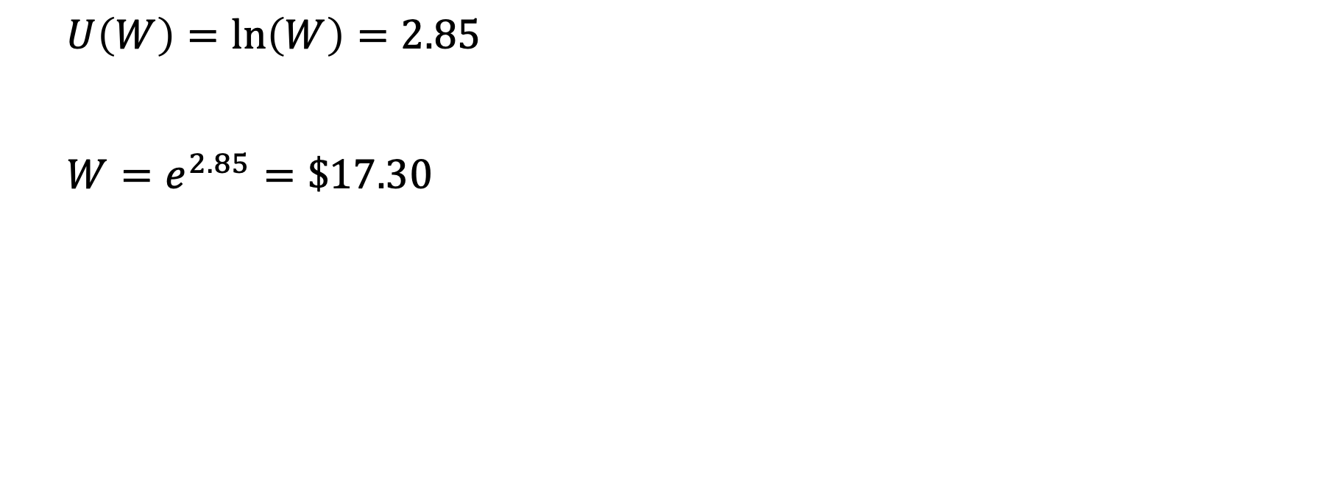
$$U\left(W\right)=\ln\left(W\right)=2.85$$
$$W=e^{2.85}=\$17.30$$

Slide 11
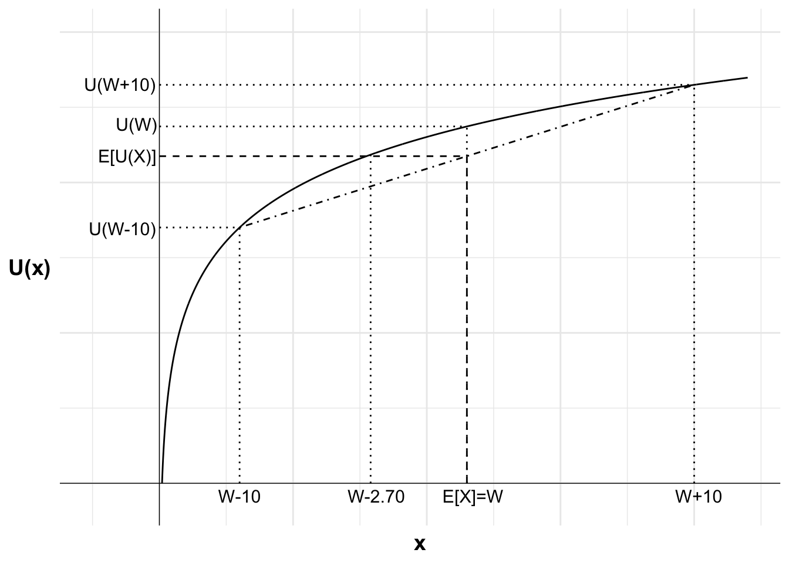

Slide 12
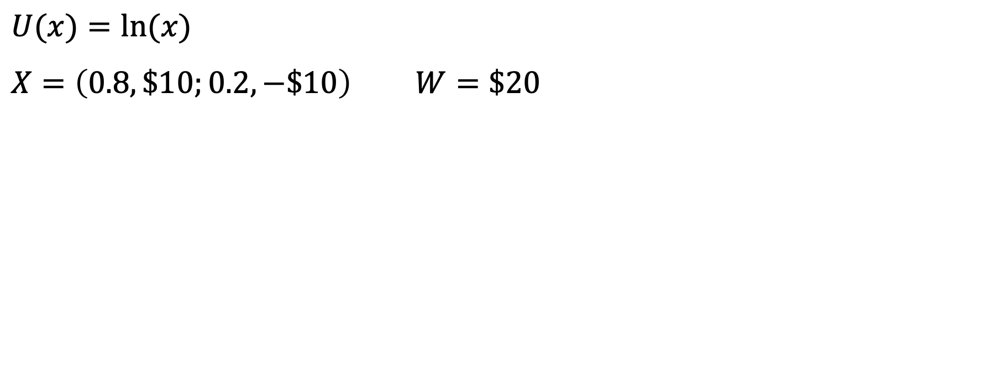
$$U(x)=ln⁡(x)$$
$$X=\left(0.8,\$10;0.2,−\$10\right) W=\$20$$

Slide 13
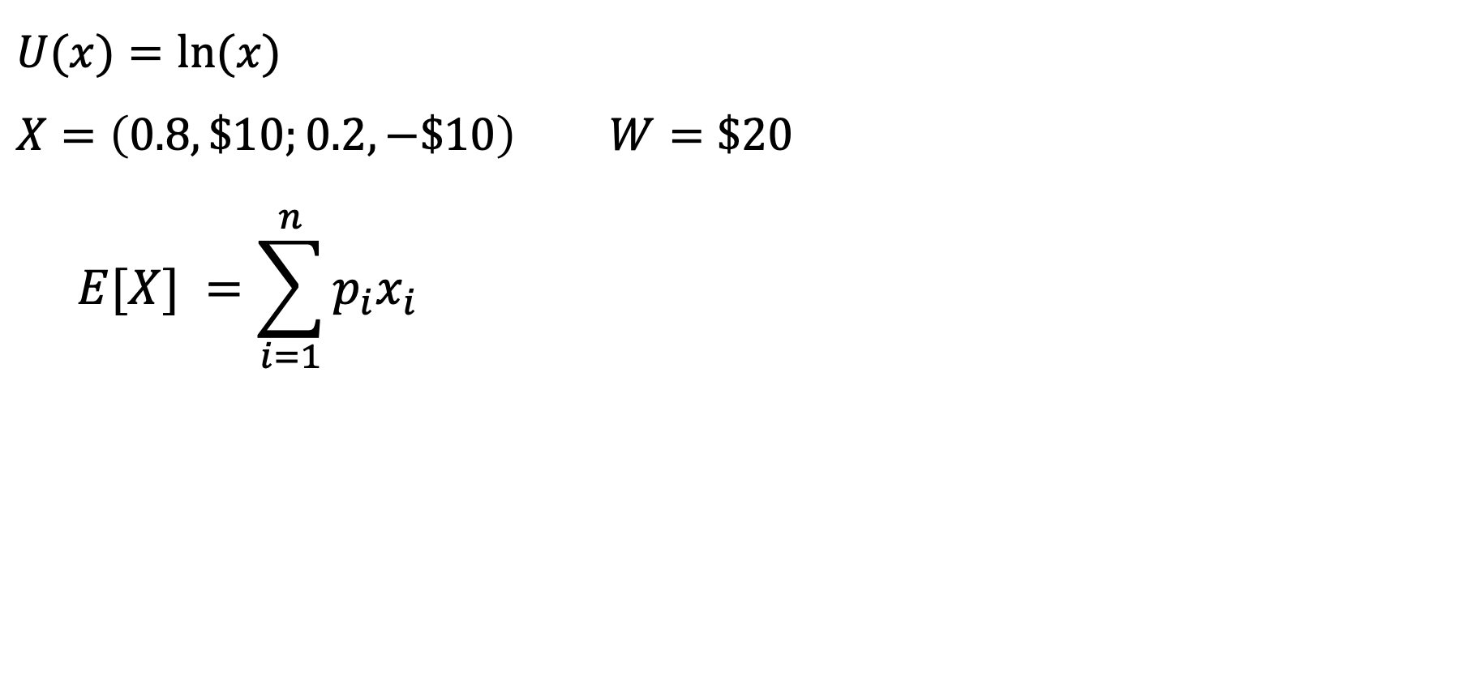
$$U(x)=ln⁡(x)$$
$$X=\left(0.8,\$10;0.2,−\$10\right) W=\$20$$
$$E[X] =\sum_{i=1}^{n}{p_{i}x_{i}}$$

Slide 14
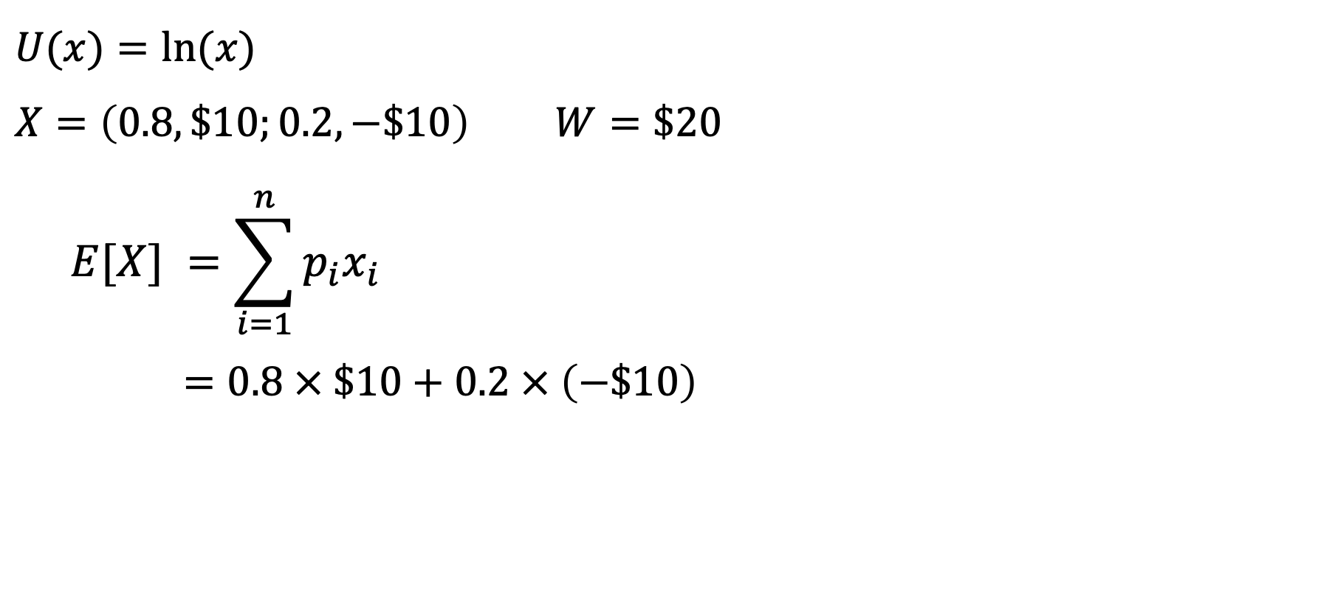
$$U(x)=ln⁡(x)$$
$$X=\left(0.8,\$10;0.2,−\$10\right) W=\$20$$
$$E[X] =\sum_{i=1}^{n}{p_{i}x_{i}}$$
$$=0.8 × \$10+0.2 × \left(−\$10\right)$$

Slide 15
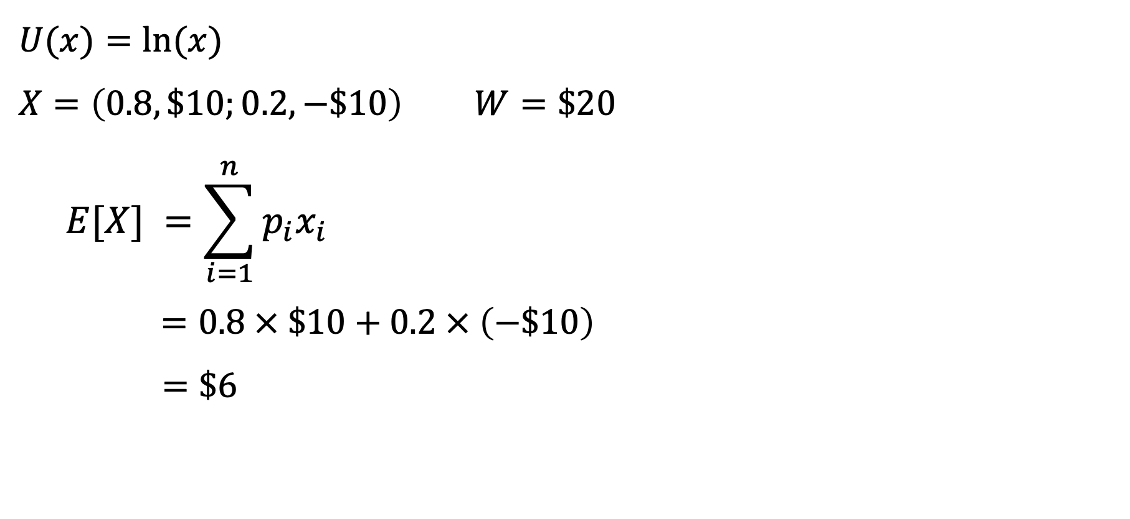
$$U(x)=ln⁡(x)$$
$$X=\left(0.8,\$10;0.2,−\$10\right) W=\$20$$
$$E[X] =\sum_{i=1}^{n}{p_{i}x_{i}}$$
$$=0.8 × \$10+0.2 × \left(−\$10\right)$$
$$=\$6$$

Slide 16
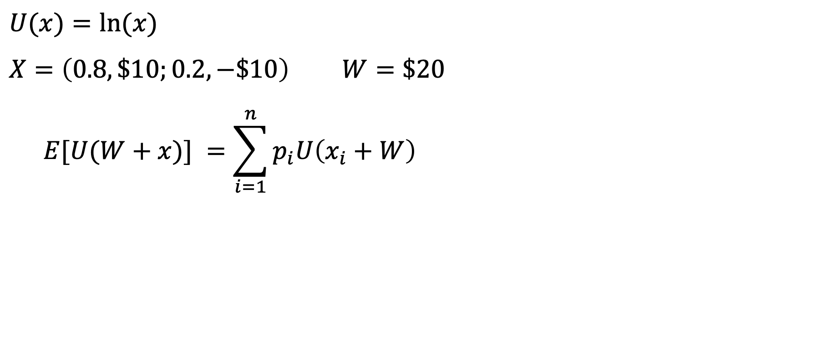
$$U(x)=ln⁡(x)$$
$$X=\left(0.8,\$10;0.2,−\$10\right) W=\$20$$
$$E[U(W+x)] =\sum_{i=1}^{n}{p_{i}U\left(x_{i}+W\right)}$$

Slide 17
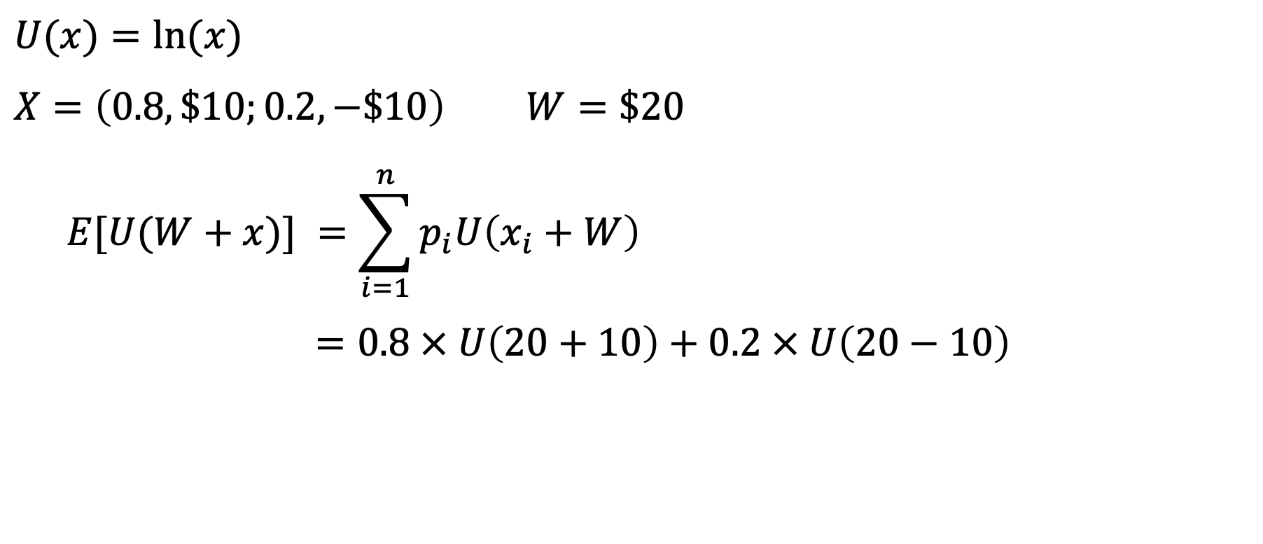
$$U(x)=ln⁡(x)$$
$$X=\left(0.8,\$10;0.2,−\$10\right) W=\$20$$
$$E[U(W+x)] =\sum_{i=1}^{n}{p_{i}U\left(x_{i}+W\right)}$$
$$=0.8 × U\left(20+10\right)+0.2 × U\left(20−10\right)$$

Slide 18
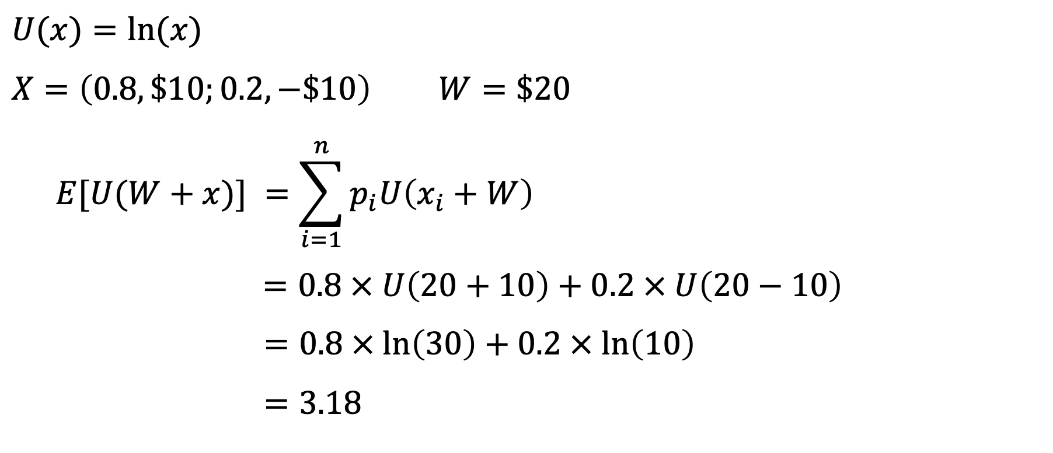
$$U(x)=ln⁡(x)$$
$$X=\left(0.8,\$10;0.2,−\$10\right) W=\$20$$
$$E[U(W+x)] =\sum_{i=1}^{n}{p_{i}U\left(x_{i}+W\right)}$$
$$=0.8 × U\left(20+10\right)+0.2 × U\left(20−10\right)$$
$$=0.8 × ln\left(30\right)+0.2 × ln\left(10\right)$$
$$=3.18$$

Slide 19
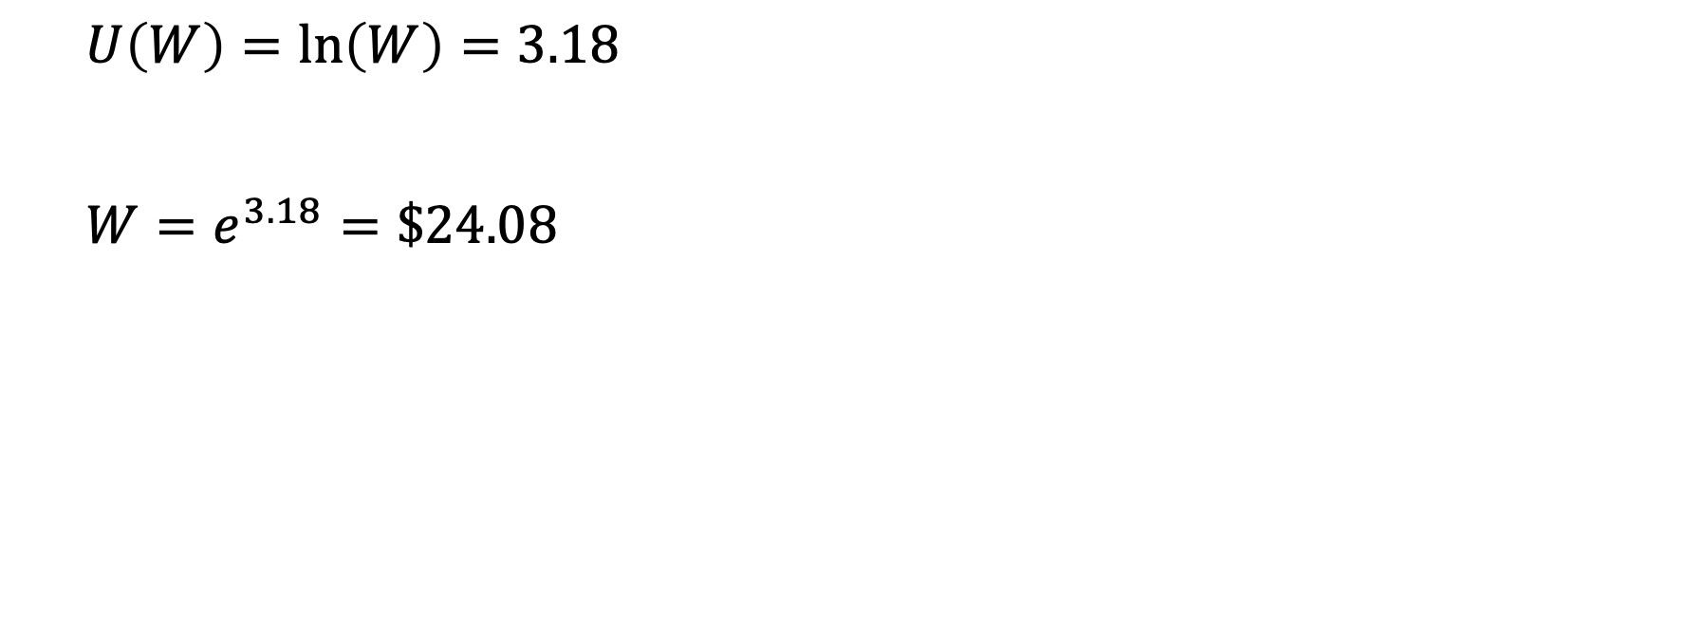
$$U\left(W\right)=\ln\left(W\right)=3.18$$
$$W=e^{3.18}=\$24.08$$

Slide 20
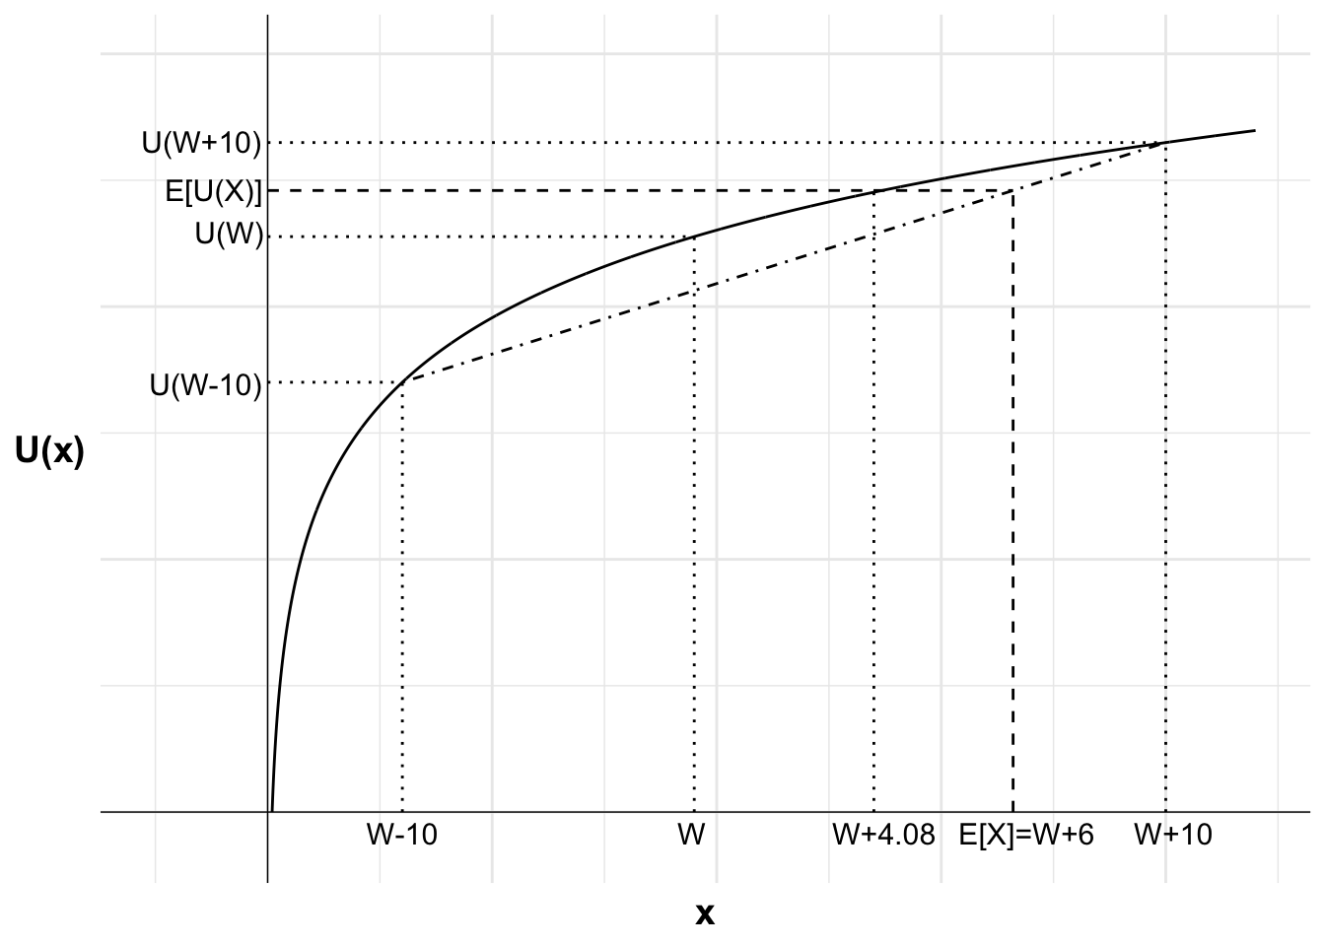

Slide 21
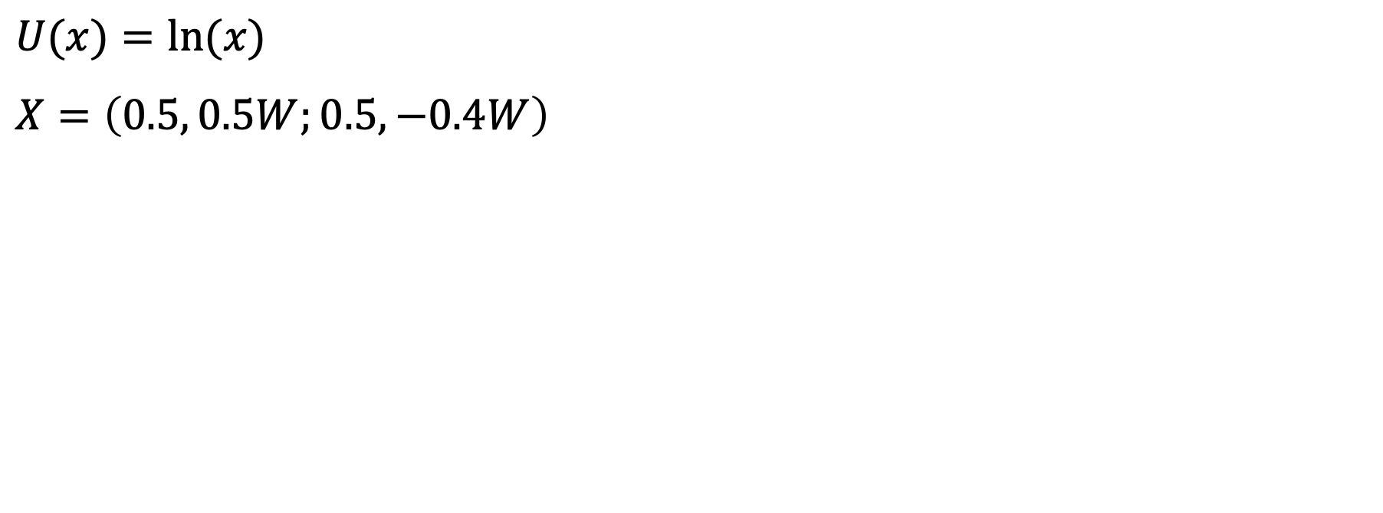
$$U(x)=ln⁡(x)$$
$$X=\left(0.5, 0.5W;0.5, −0.4W\right)$$

Slide 22
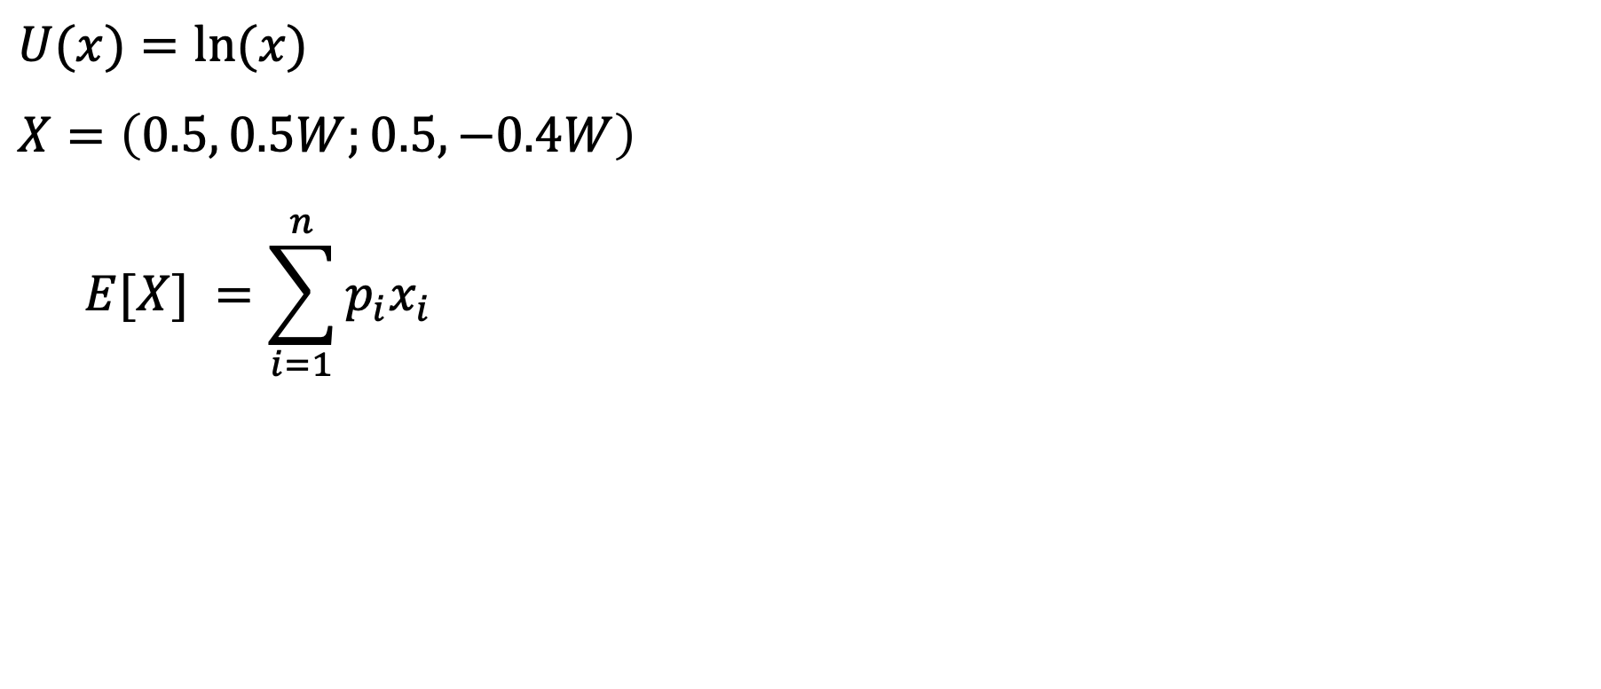
$$U(x)=ln⁡(x)$$
$$X=\left(0.5, 0.5W;0.5,−0.4W\right)$$
$$E[X] =\sum_{i=1}^{n}{p_{i}x_{i}}$$

Slide 23
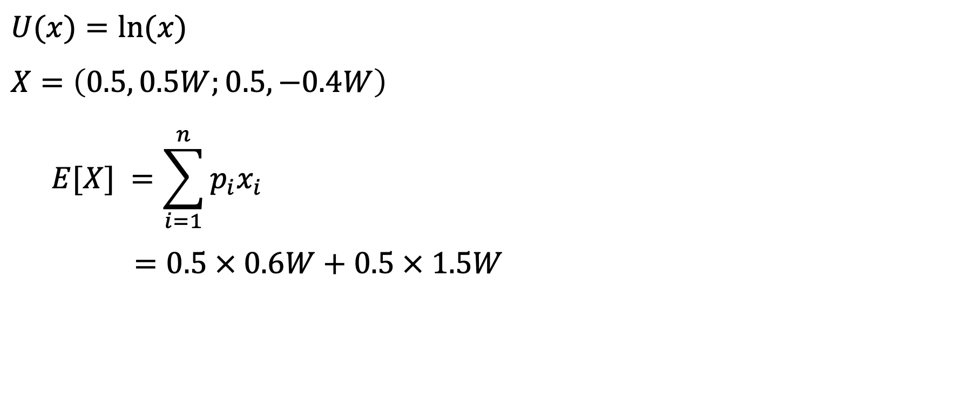
$$U(x)=ln⁡(x)$$
$$X=\left(0.5, 0.5W;0.5,−0.4W\right)$$
$$E[X] =\sum_{i=1}^{n}{p_{i}x_{i}}$$
$$=0.5 × 0.6W+0.5 × 1.5W$$

Slide 24
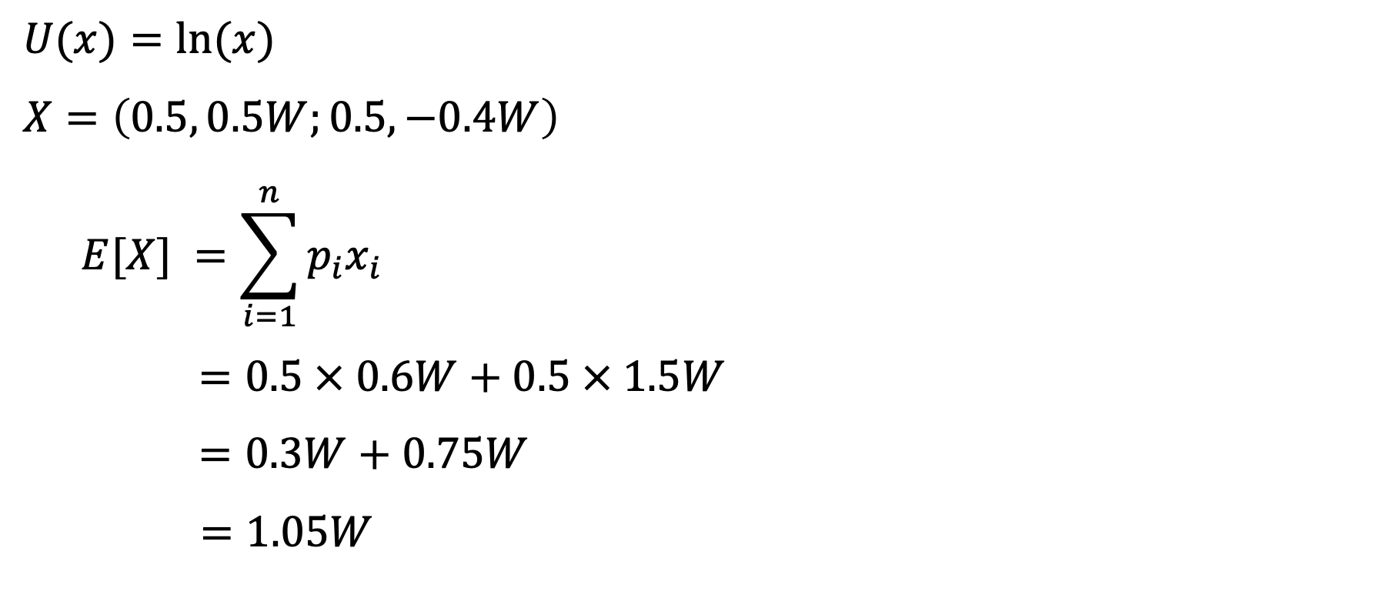
$$U(x)=ln⁡(x)$$
$$X=\left(0.5, 0.5W;0.5,−0.4W\right)$$
$$E[X] =\sum_{i=1}^{n}{p_{i}x_{i}}$$
$$=0.5 × 0.6W+0.5 × 1.5W$$
$$=0.3W+0.75W$$
$$=1.05W$$

Slide 25
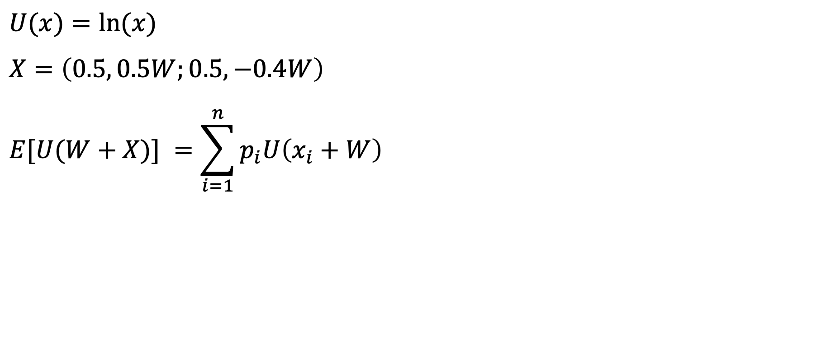
$$U(x)=ln⁡(x)$$
$$X=\left(0.5, 0.5W;0.5,−0.4W\right)$$
$$E[U(W+X)] =\sum_{i=1}^{n}{p_{i}U\left(x_{i}+W\right)}$$

Slide 26
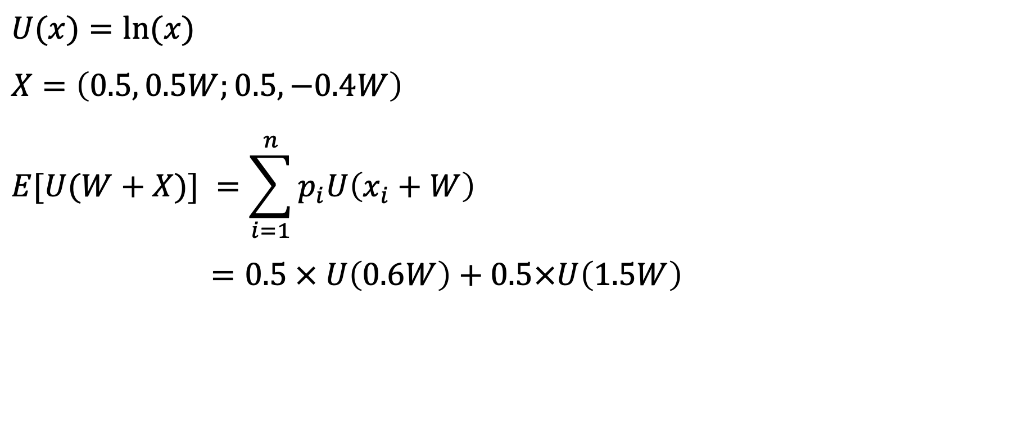
$$U(x)=ln⁡(x)$$
$$X=\left(0.5, 0.5W;0.5,−0.4W\right)$$
$$E[U(W+X)] =\sum_{i=1}^{n}{p_{i}U\left(x_{i}+W\right)}$$
$$=0.5 × U\left(0.6W\right)+0.5×U\left(1.5W\right)$$

Slide 27
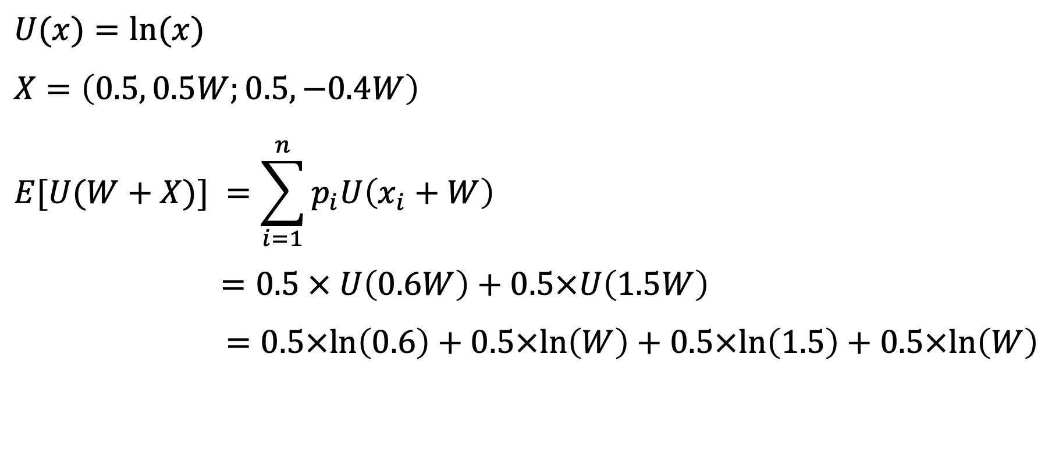
$$U(x)=ln⁡(x)$$
$$X=\left(0.5, 0.5W;0.5,−0.4W\right)$$
$$E[U(W+X)] =\sum_{i=1}^{n}{p_{i}U\left(x_{i}+W\right)}$$
$$=0.5 × U\left(0.6W\right)+0.5×U\left(1.5W\right)$$
$$=0.5×ln\left(0.6\right)+0.5×ln\left(W\right)+0.5×ln\left(1.5\right)+0.5×ln\left(W\right)$$

Slide 28
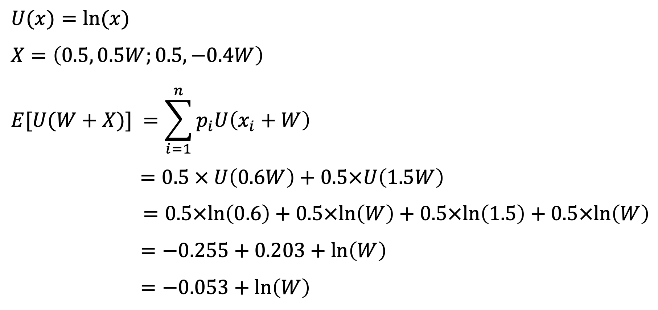
$$U(x)=ln⁡(x)$$
$$X=\left(0.5, 0.5W;0.5,−0.4W\right)$$
$$E[U(W+X)] =\sum_{i=1}^{n}{p_{i}U\left(x_{i}+W\right)}$$
$$=0.5 × U\left(0.6W\right)+0.5×U\left(1.5W\right)$$
$$=0.5×ln\left(0.6\right)+0.5×ln\left(W\right)+0.5×ln\left(1.5\right)+0.5×ln\left(W\right)$$
$$=−0.255+0.203+ln\left(W\right)$$
$$=−0.053+ln\left(W\right)$$

Slide 29
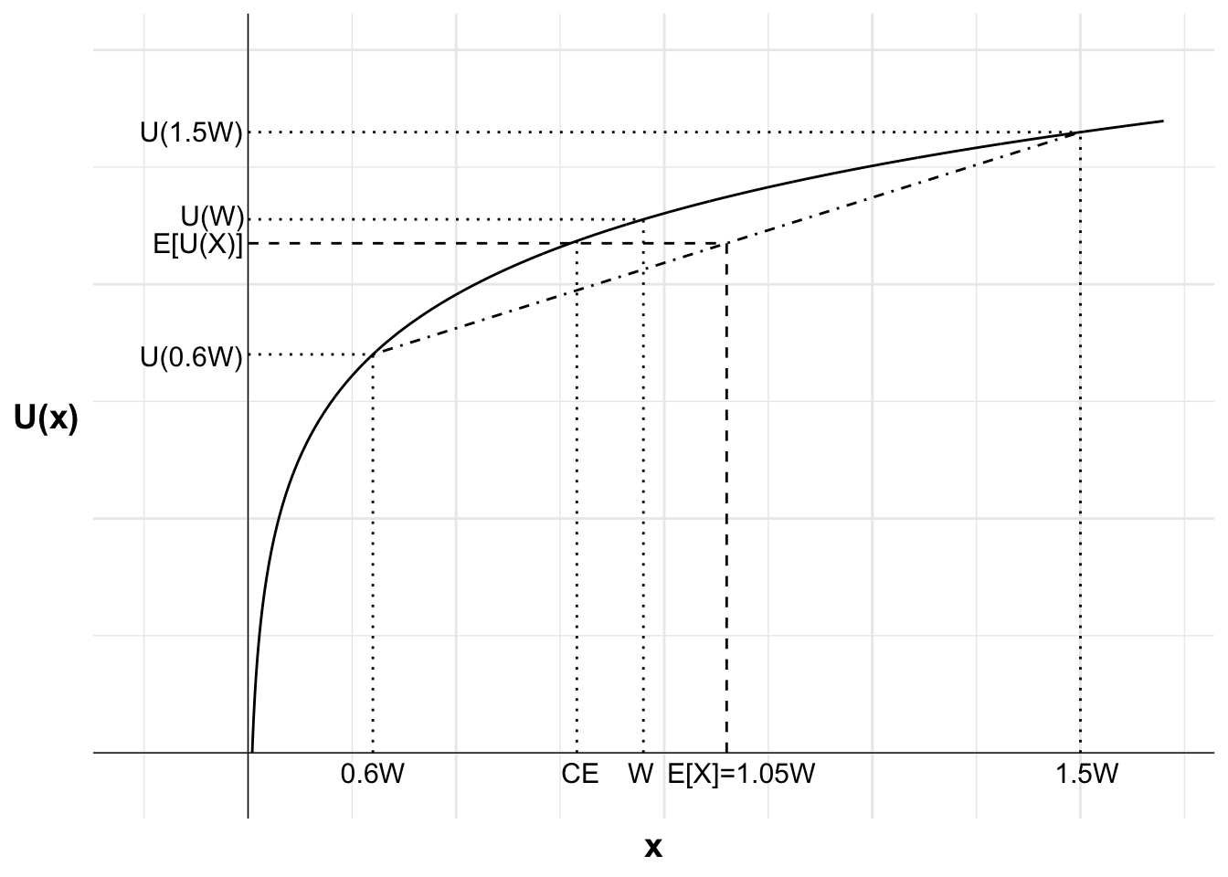

Slide 30

The St. Petersburg game

Slide 31
The St. Petersburg game
Tail on the 1st flip: $2
Tail on the 2nd flip: $4
Tail on the 3rd flip: $8
Tail on the 4th flip: $16
And so on.

Slide 32
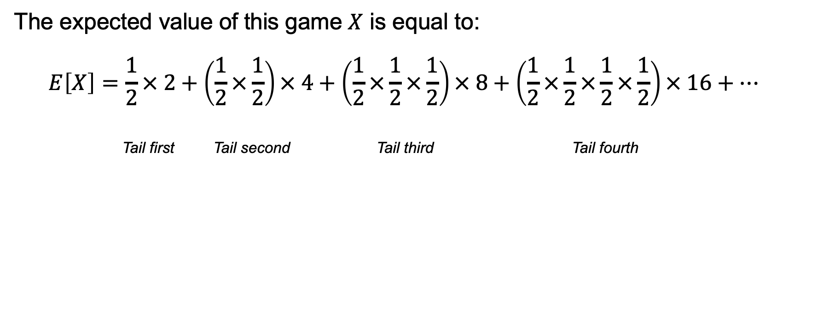
The St. Petersburg game
The expected value of this game $X$ is equal to:
$$E\left[X\right]=\frac{1}{2}× 2+\left(\frac{1}{2}×\frac{1}{2}\right)× 4+\left(\frac{1}{2}×\frac{1}{2}×\frac{1}{2}\right)× 8+\left(\frac{1}{2}×\frac{1}{2}×\frac{1}{2}×\frac{1}{2}\right)× 16+…$$
Tail first Tail second Tail third Tail fourth

Slide 33
The St. Petersburg game
The expected value of this game $X$ is equal to:
$$E\left[X\right]=\frac{1}{2}× 2+\left(\frac{1}{2}×\frac{1}{2}\right)× 4+\left(\frac{1}{2}×\frac{1}{2}×\frac{1}{2}\right)× 8+\left(\frac{1}{2}×\frac{1}{2}×\frac{1}{2}×\frac{1}{2}\right)× 16+…$$
Tail first Tail second Tail third Tail fourth

Slide 34
The St. Petersburg game
The expected value of this game $X$ is equal to:
$$E\left[X\right]=\frac{1}{2}× 2+\left(\frac{1}{2}×\frac{1}{2}\right)× 4+\left(\frac{1}{2}×\frac{1}{2}×\frac{1}{2}\right)× 8+\left(\frac{1}{2}×\frac{1}{2}×\frac{1}{2}×\frac{1}{2}\right)× 16+…$$
Tail first Tail second Tail third Tail fourth

Slide 35
The St. Petersburg game
The expected value of this game $X$ is equal to:
$$E\left[X\right]=\frac{1}{2}× 2+\left(\frac{1}{2}×\frac{1}{2}\right)× 4+\left(\frac{1}{2}×\frac{1}{2}×\frac{1}{2}\right)× 8+\left(\frac{1}{2}×\frac{1}{2}×\frac{1}{2}×\frac{1}{2}\right)× 16+…$$
Tail first Tail second Tail third Tail fourth

Slide 36
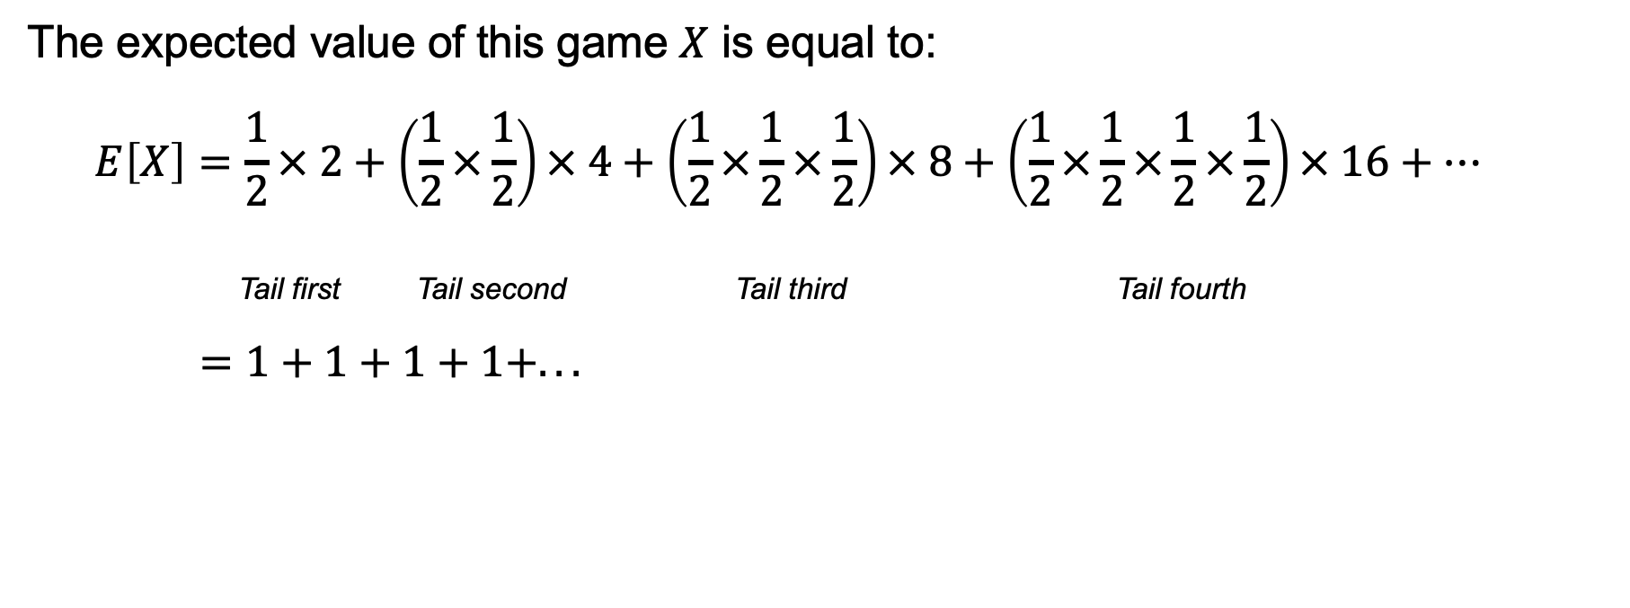
The St. Petersburg game
The expected value of this game $X$ is equal to:
$$E\left[X\right]=\frac{1}{2}× 2+\left(\frac{1}{2}×\frac{1}{2}\right)× 4+\left(\frac{1}{2}×\frac{1}{2}×\frac{1}{2}\right)× 8+\left(\frac{1}{2}×\frac{1}{2}×\frac{1}{2}×\frac{1}{2}\right)× 16+…$$
Tail first Tail second Tail third Tail fourth
$=1+1+1+1+...$

Slide 37
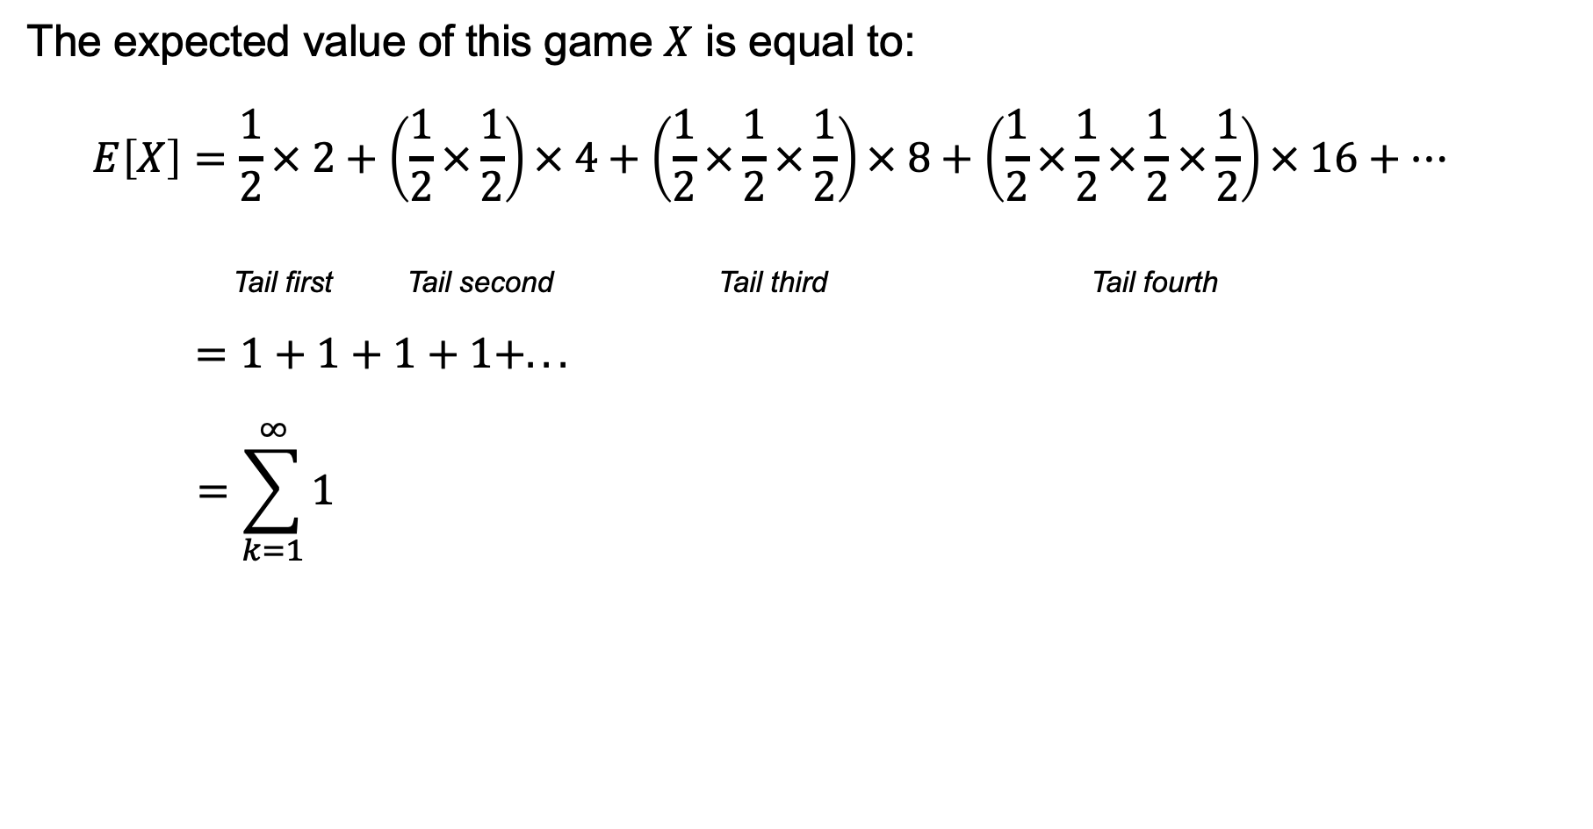
The St. Petersburg game
The expected value of this game $X$ is equal to:
$$E\left[X\right]=\frac{1}{2}× 2+\left(\frac{1}{2}×\frac{1}{2}\right)× 4+\left(\frac{1}{2}×\frac{1}{2}×\frac{1}{2}\right)× 8+\left(\frac{1}{2}×\frac{1}{2}×\frac{1}{2}×\frac{1}{2}\right)× 16+…$$
Tail first Tail second Tail third Tail fourth
$=1+1+1+1+...$
$$=\sum_{k=1}^{∞}{1}$$

Slide 38
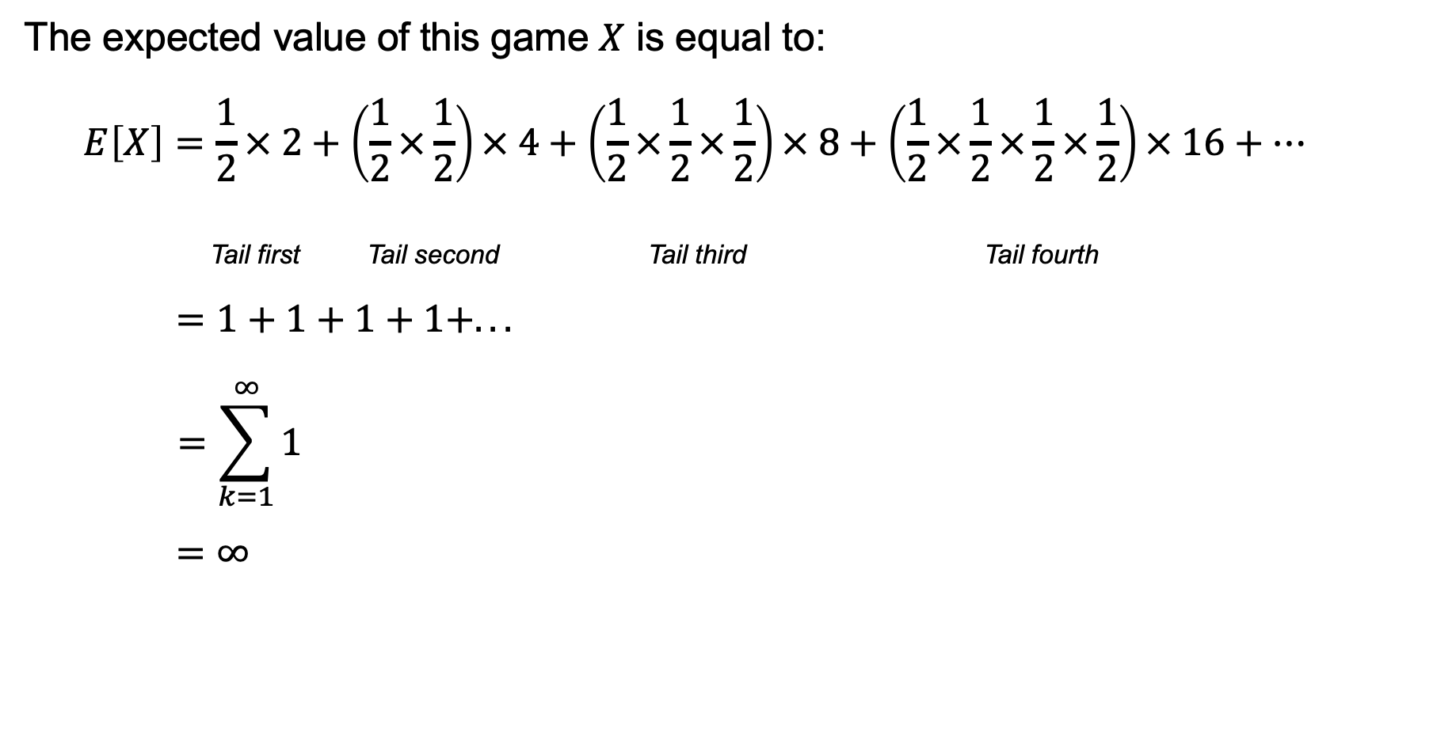
The St. Petersburg game
The expected value of this game $X$ is equal to:
$$E\left[X\right]=\frac{1}{2}× 2+\left(\frac{1}{2}×\frac{1}{2}\right)× 4+\left(\frac{1}{2}×\frac{1}{2}×\frac{1}{2}\right)× 8+\left(\frac{1}{2}×\frac{1}{2}×\frac{1}{2}×\frac{1}{2}\right)× 16+…$$
Tail first Tail second Tail third Tail fourth
$=1+1+1+1+...$
$$=\sum_{k=1}^{∞}{1}$$
$=∞$

Slide 39
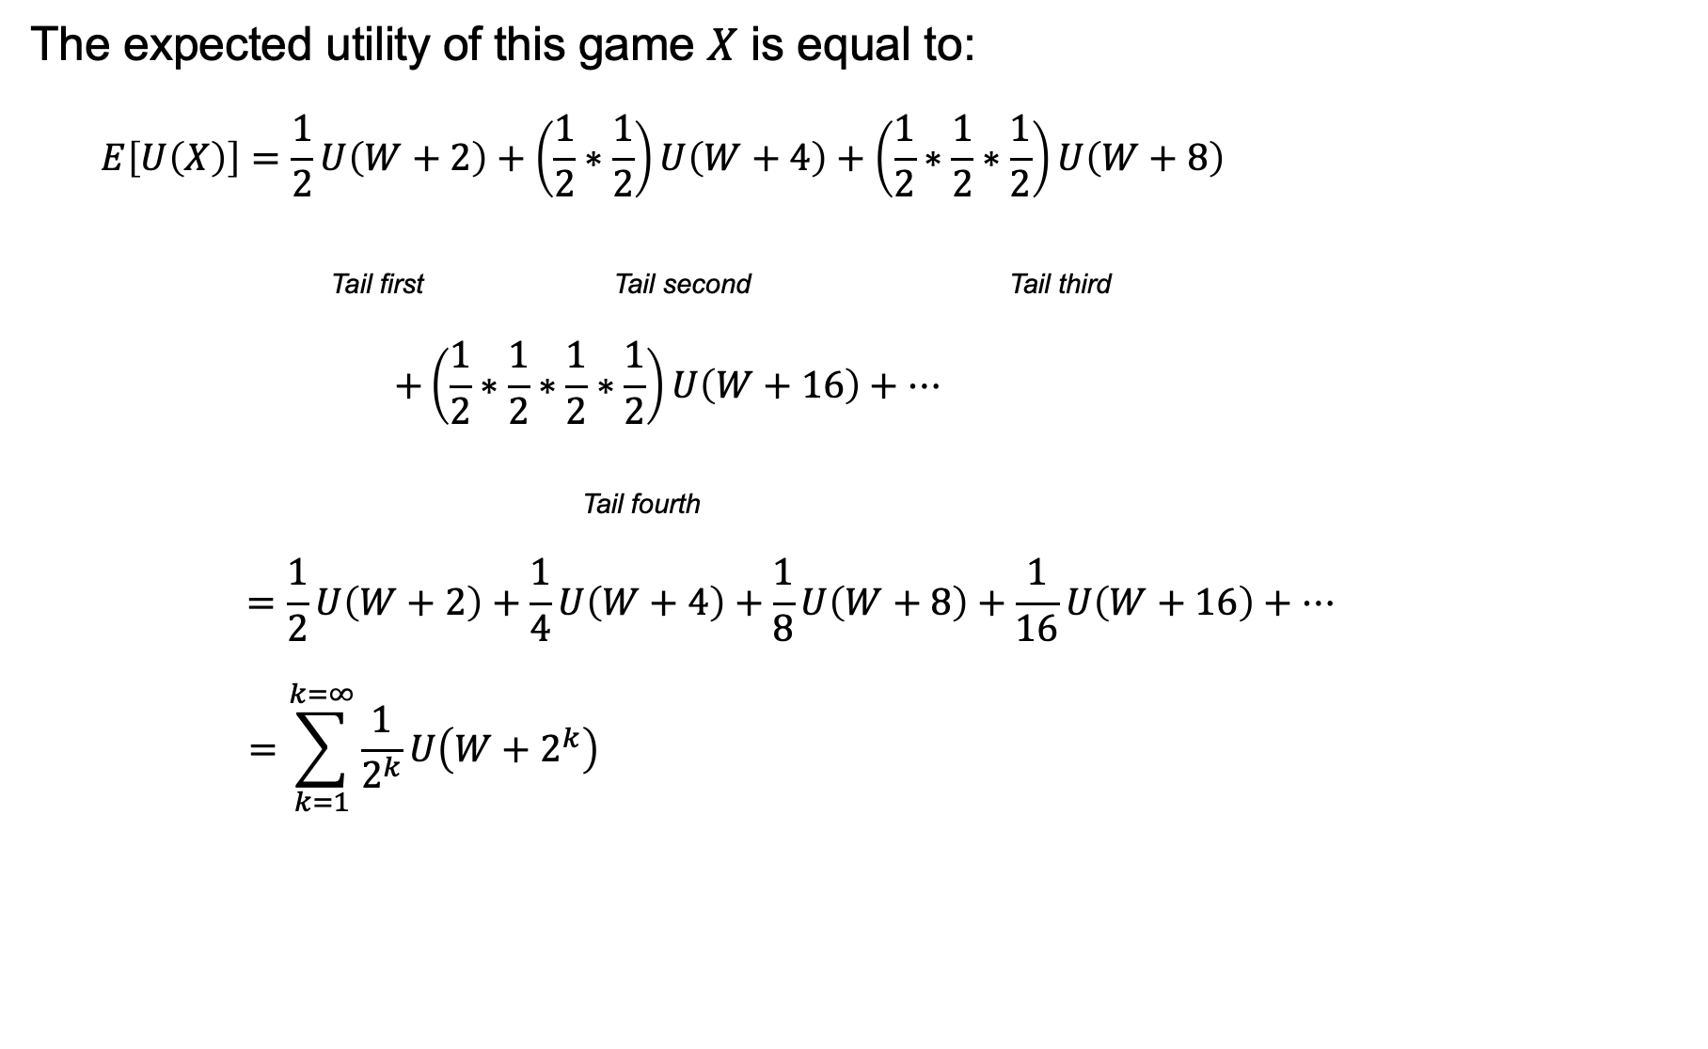
The St. Petersburg game
The expected utility of this game $X$ is equal to:
$$E\left[U\left(X\right)\right]=\frac{1}{2}U\left(W+2\right)+\left(\frac{1}{2}∗\frac{1}{2}\right)U\left(W+4\right)+\left(\frac{1}{2}∗\frac{1}{2}∗\frac{1}{2}\right)U\left(W+8\right)$$
Tail first Tail second Tail third
$$+\left(\frac{1}{2}∗\frac{1}{2}∗\frac{1}{2}∗\frac{1}{2}\right)U\left(W+16\right)+…$$
Tail fourth
$$=\frac{1}{2}U\left(W+2\right)+\frac{1}{4}U\left(W+4\right)+\frac{1}{8}U\left(W+8\right)+\frac{1}{16}U\left(W+16\right)+…$$
$$=\sum_{k=1}^{k=∞}{\frac{1}{2^{k}}U\left(W+2^{k}\right)}$$

Slide 40
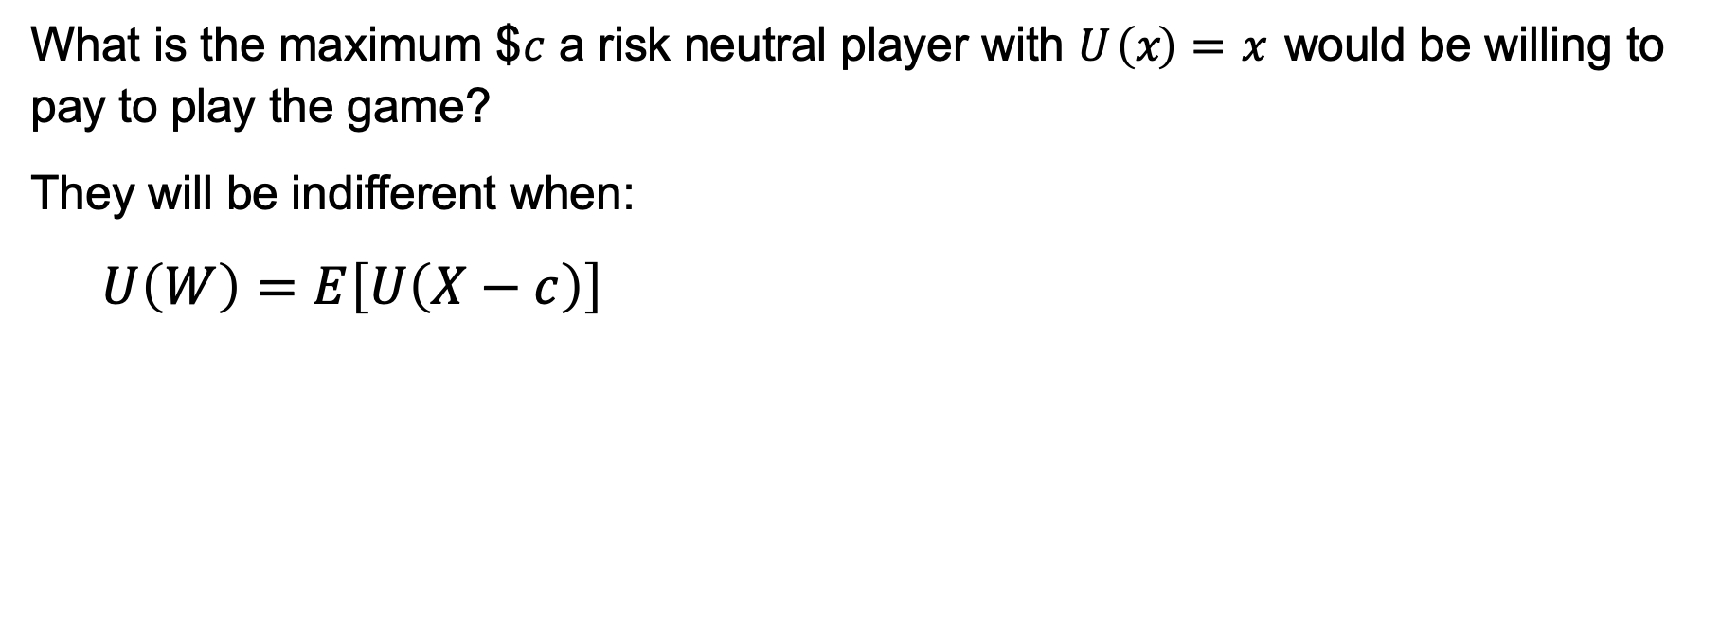
The St. Petersburg game
What is the maximum $$c$ a risk neutral player with $U \left(x\right)=x$ would be willing to pay to play the game?
They will be indifferent when:
$$U\left(W\right)=E\left[U\left(X−c\right)\right]$$

Slide 41
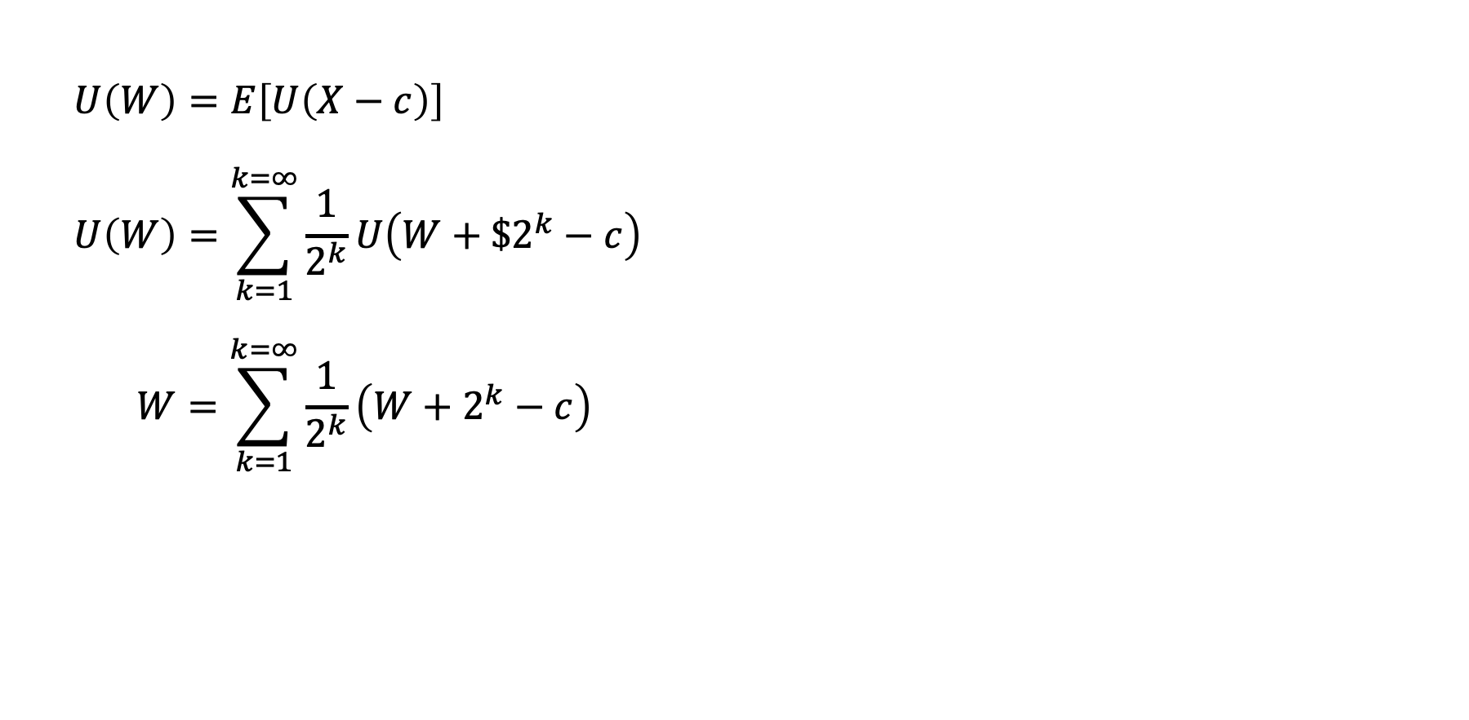
The St. Petersburg game
$$U\left(W\right)=E\left[U\left(X−c\right)\right]$$
$$U\left(W\right)=\sum_{k=1}^{k=∞}{\frac{1}{2^{k}}U\left(W+\$2^{k}−c\right)}$$
$$W=\sum_{k=1}^{k=∞}{\frac{1}{2^{k}}\left(W+2^{k}−c\right)}$$

Slide 42
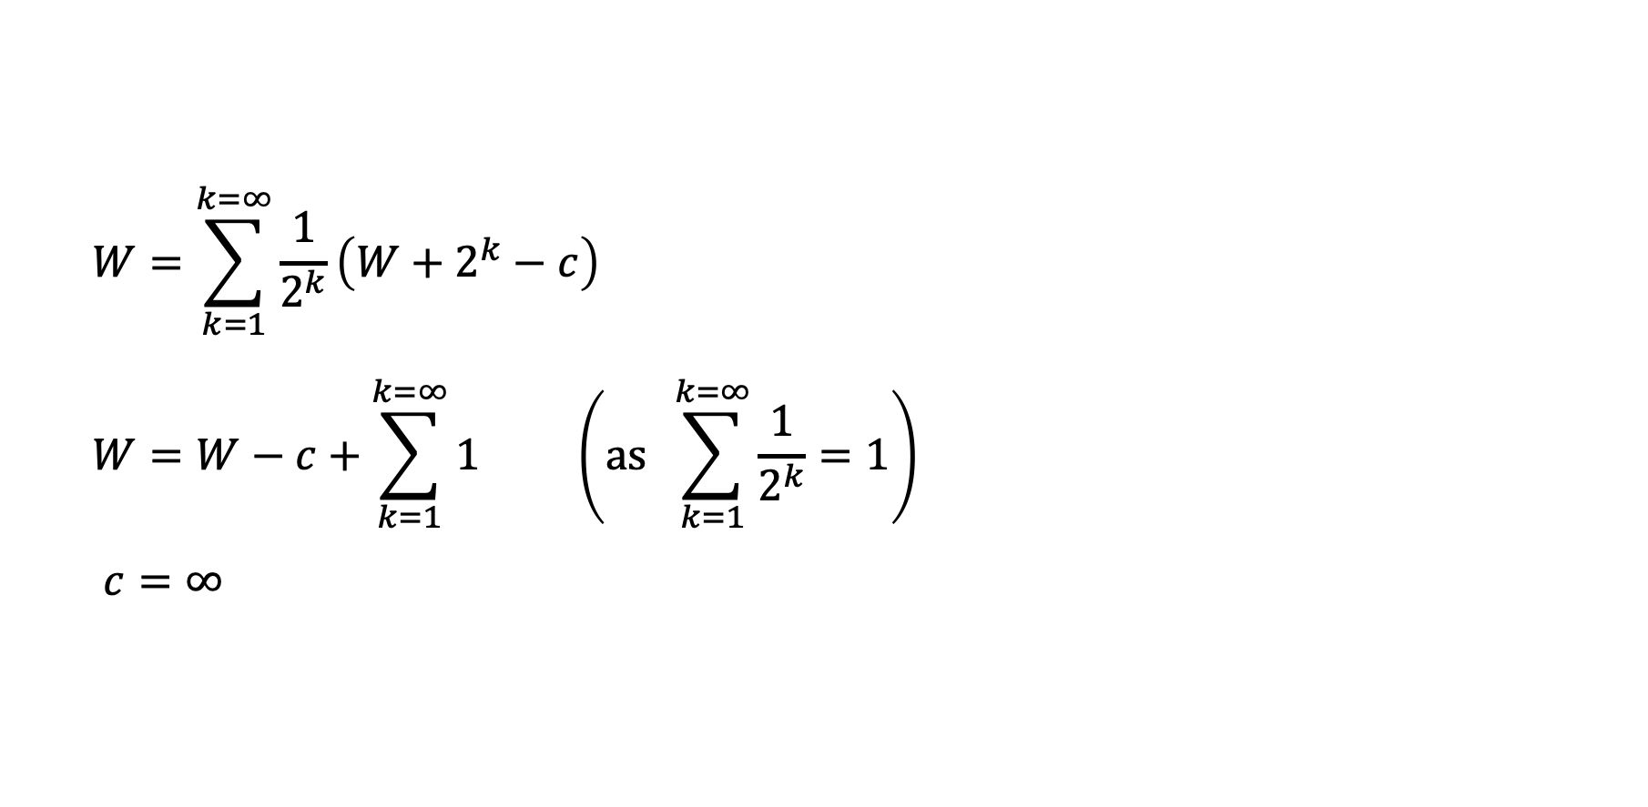
The St. Petersburg game
$$W=\sum_{k=1}^{k=∞}{\frac{1}{2^{k}}\left(W+2^{k}−c\right)}$$
$$W=W−c+\sum_{k=1}^{k=∞}{1} \left(as \sum_{k=1}^{k=∞}{\frac{1}{2^{k}}}=1\right)$$
$$c=∞$$

Slide 43
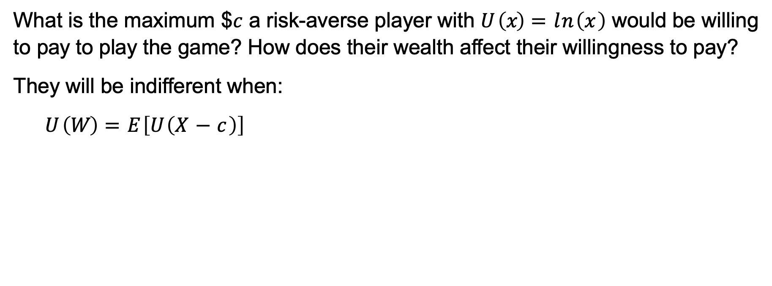
The St. Petersburg game
What is the maximum $$c$ a risk-averse player with $U \left(x\right)=ln\left(x\right)$ would be willing to pay to play the game? How does their wealth affect their willingness to pay?
They will be indifferent when:
$$U \left(W\right)=E\left[U\left(X−c\right)\right]$$

Slide 44
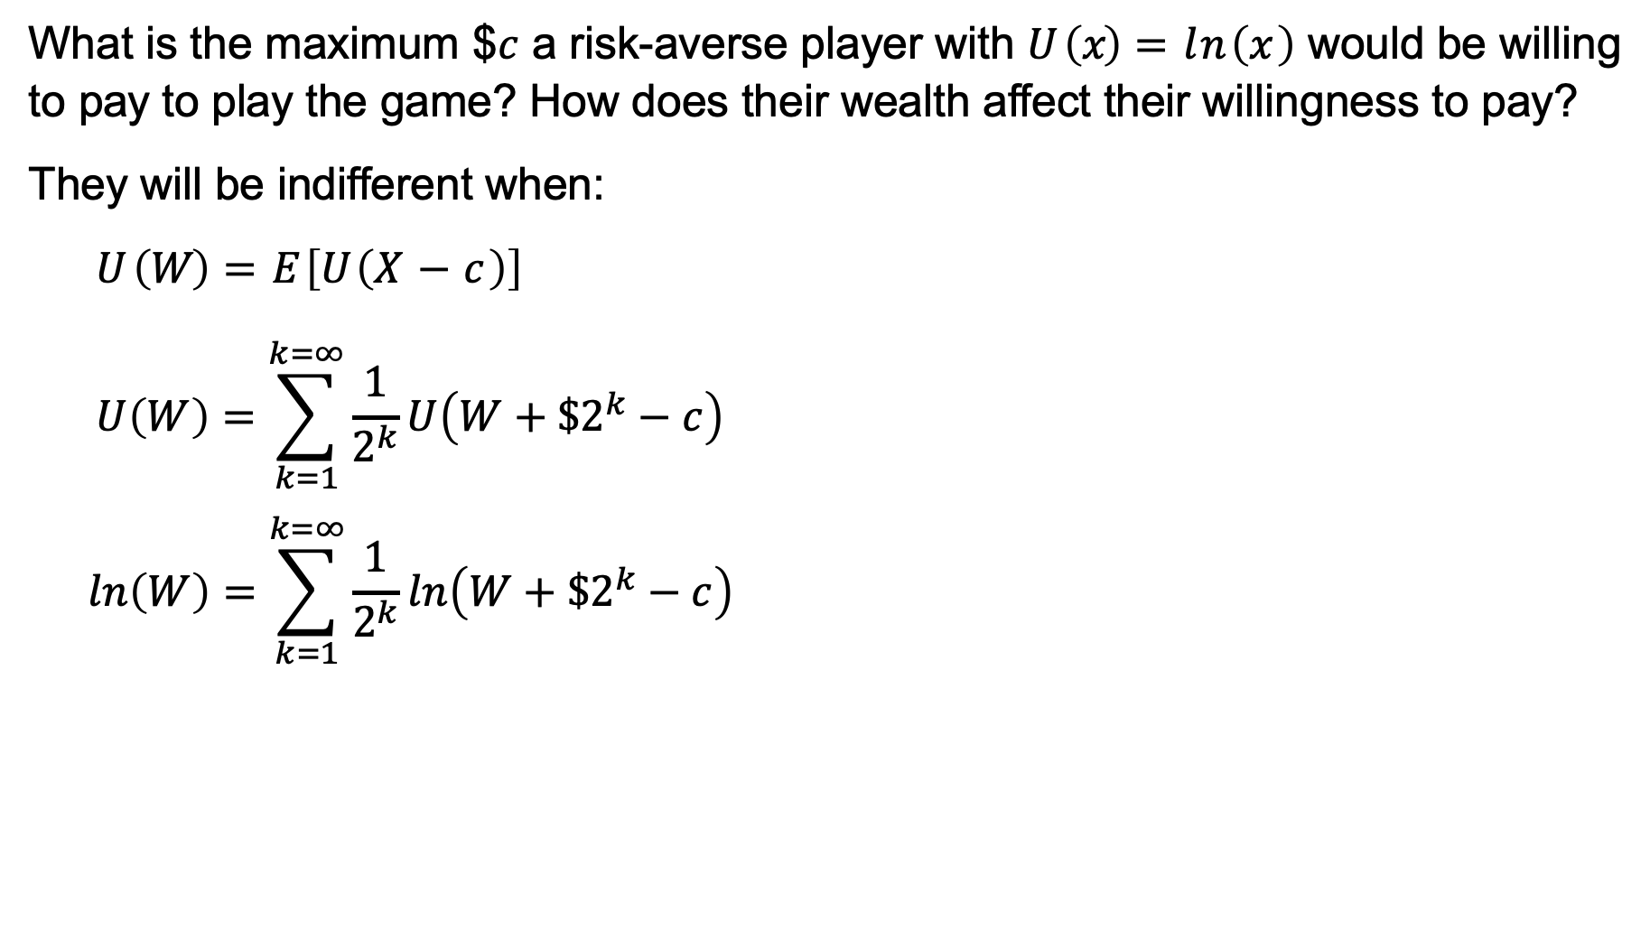
The St. Petersburg game
What is the maximum $$c$ a risk-averse player with $U \left(x\right)=ln\left(x\right)$ would be willing to pay to play the game? How does their wealth affect their willingness to pay?
They will be indifferent when:
$$U \left(W\right)=E\left[U\left(X−c\right)\right]$$
$$U\left(W\right)=\sum_{k=1}^{k=∞}{\frac{1}{2^{k}}U\left(W+\$2^{k}−c\right)}$$
$$ln\left(W\right)=\sum_{k=1}^{k=∞}{\frac{1}{2^{k}}ln\left(W+\$2^{k}−c\right)}$$

Slide 45
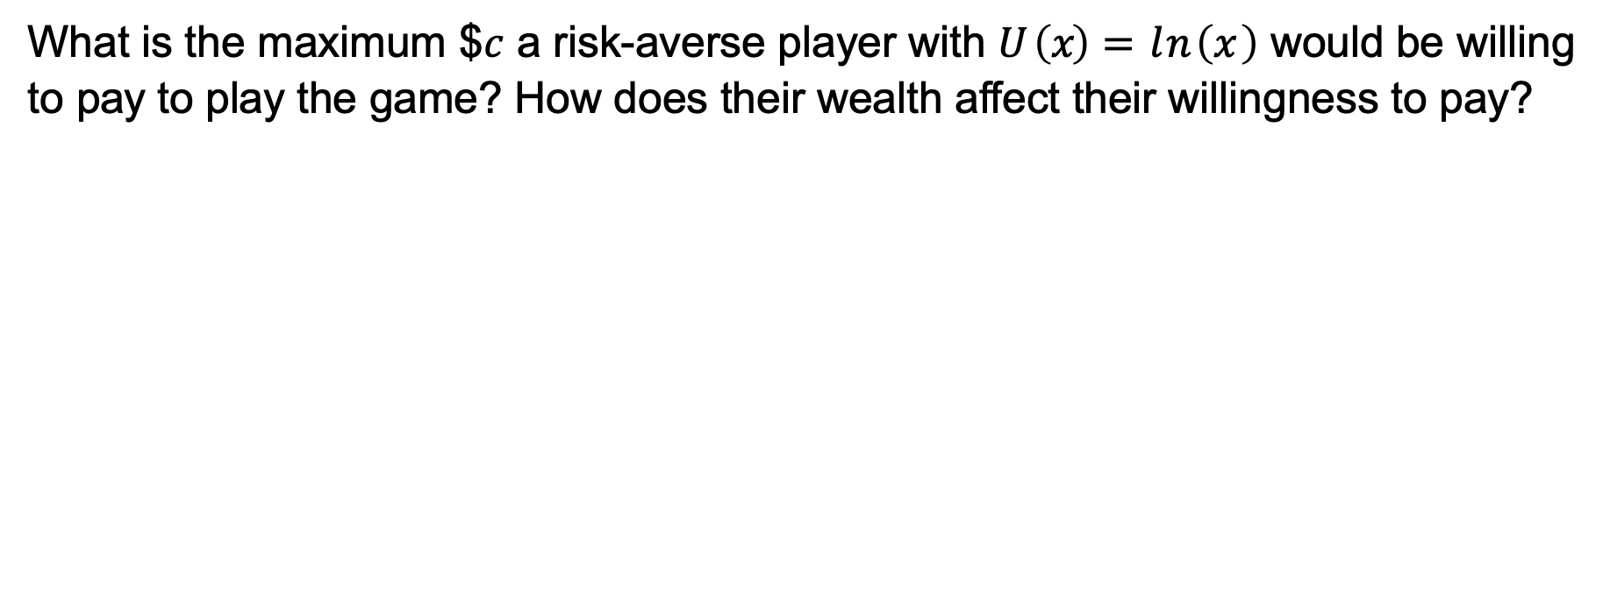
The St. Petersburg game
What is the maximum $$c$ a risk-averse player with $U \left(x\right)=ln\left(x\right)$ would be willing to pay to play the game? How does their wealth affect their willingness to pay?
Wealth | Willing to pay
$0.01 | $2.01
$1000 | $10.95
$1 million | $20.87

Slide 46
The St. Petersburg game
What is the the utility of a risk-averse player whose only asset is the opportunity to play this game?

Slide 47
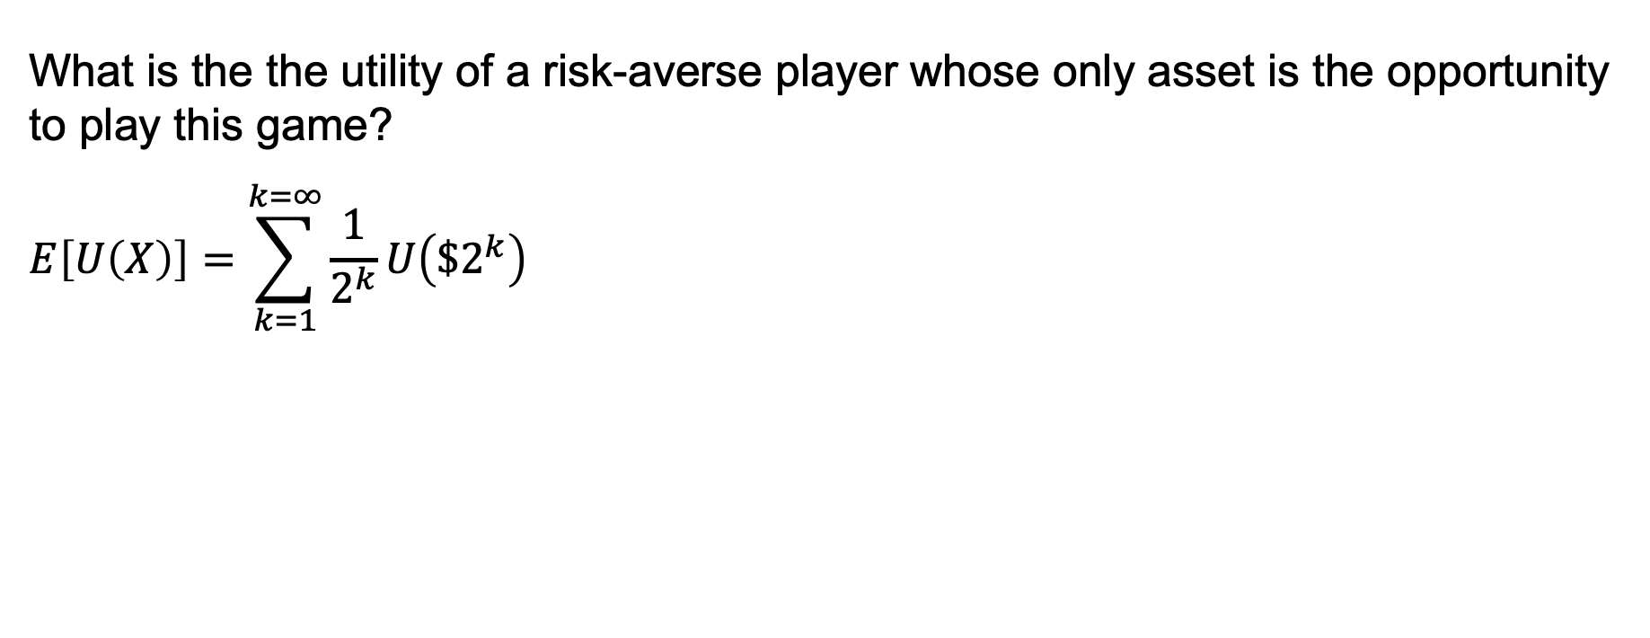
The St. Petersburg game
What is the the utility of a risk-averse player whose only asset is the opportunity to play this game?
$$E\left[U\left(X\right)\right]=\sum_{k=1}^{k=∞}{\frac{1}{2^{k}}U\left({\$2}^{k}\right)}$$

Slide 48
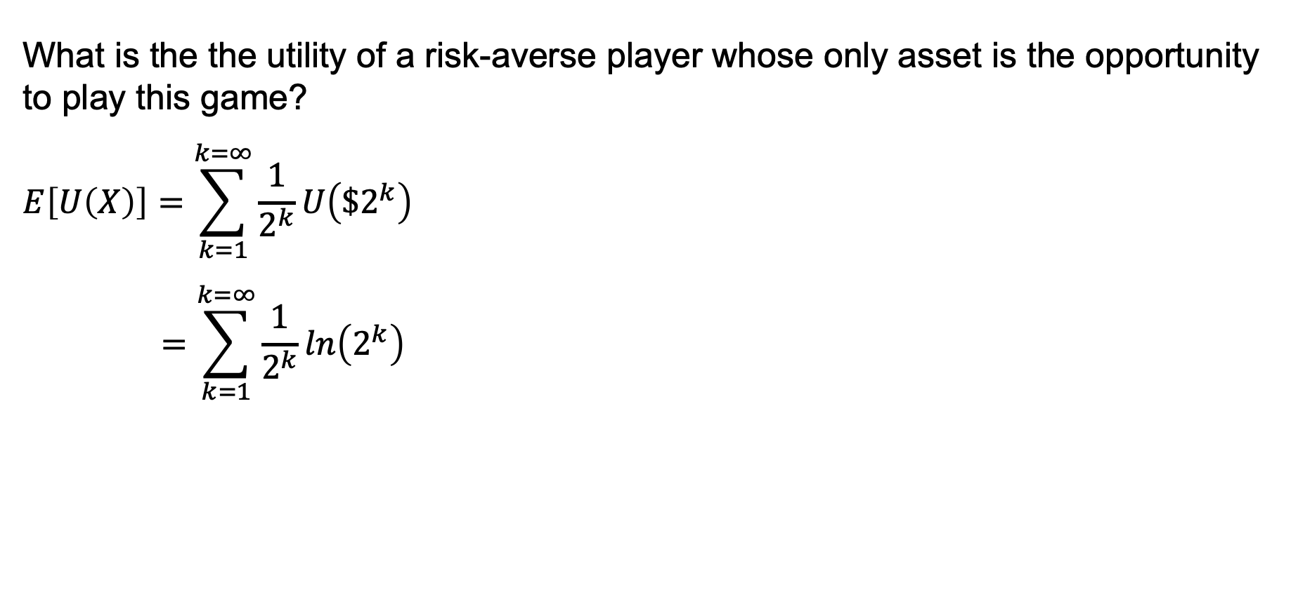
The St. Petersburg game
What is the the utility of a risk-averse player whose only asset is the opportunity to play this game?
$$E\left[U\left(X\right)\right]=\sum_{k=1}^{k=∞}{\frac{1}{2^{k}}U\left({\$2}^{k}\right)}$$
$$=\sum_{k=1}^{k=∞}{\frac{1}{2^{k}}ln\left(2^{k}\right)}$$

Slide 49
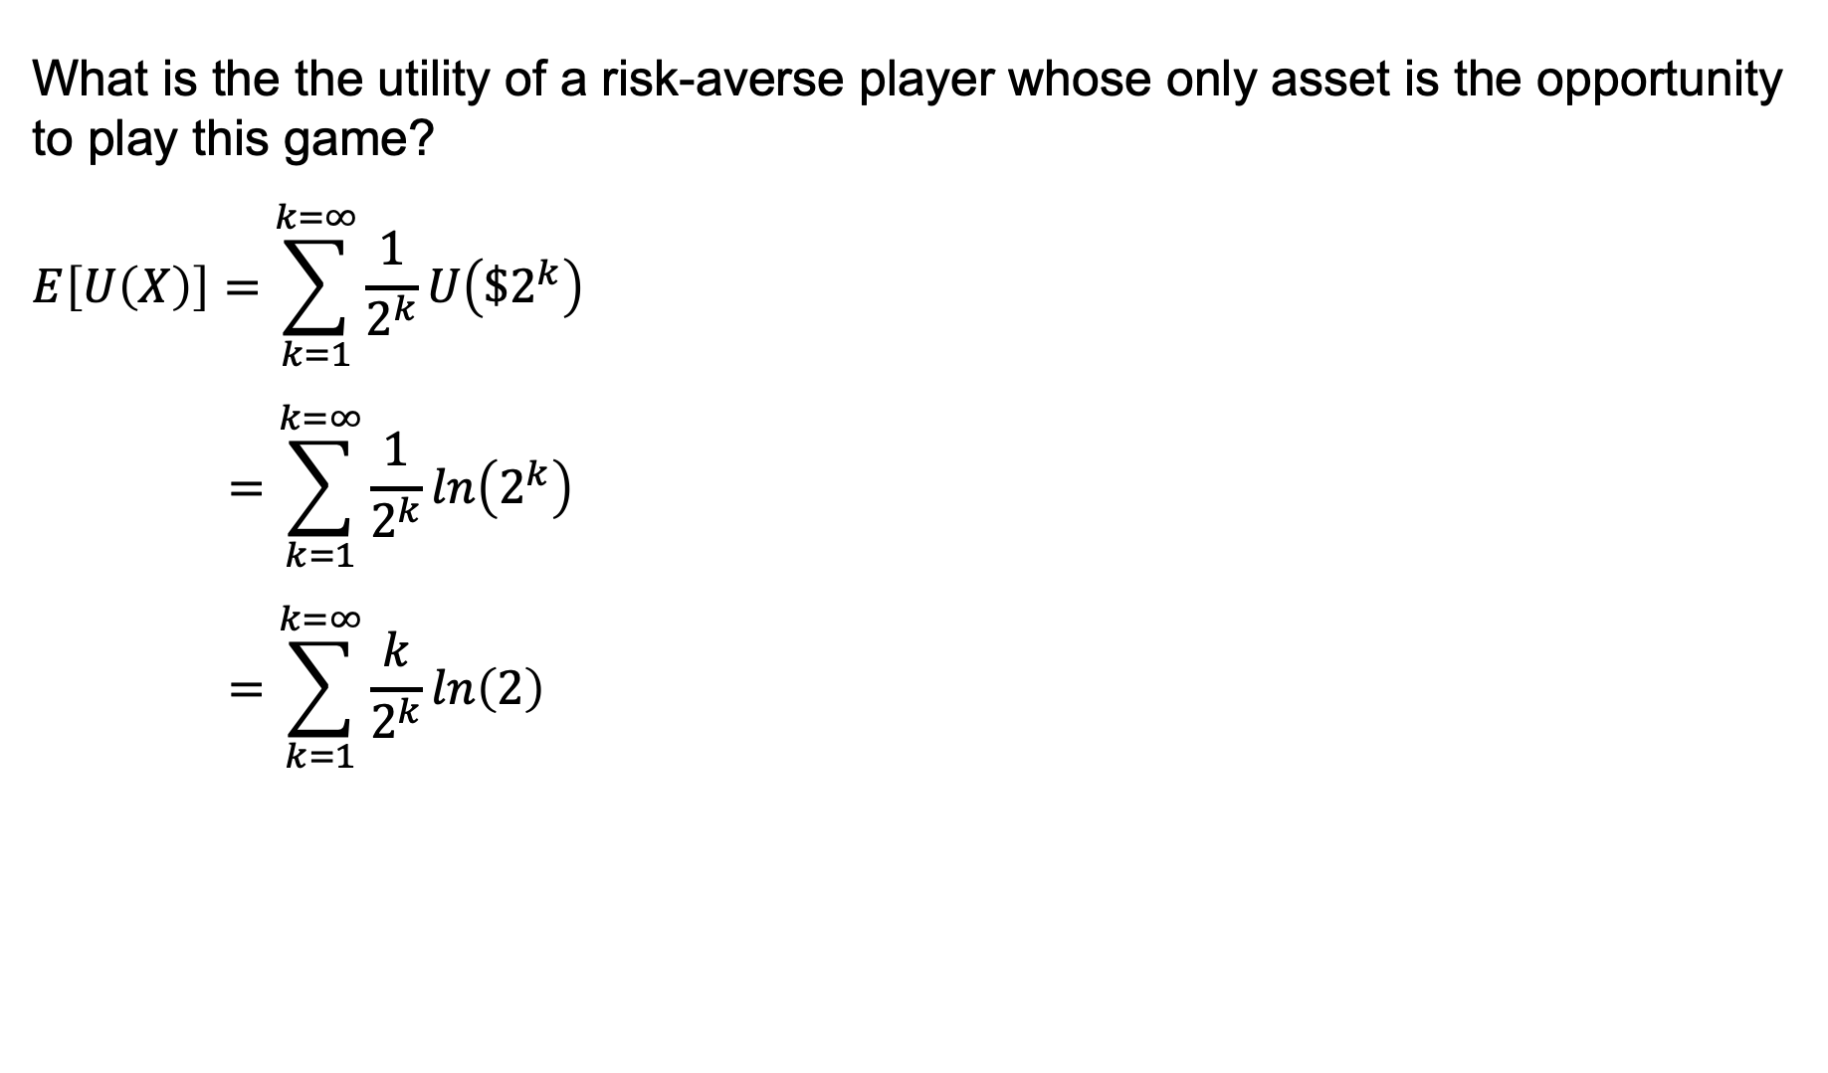
The St. Petersburg game
What is the the utility of a risk-averse player whose only asset is the opportunity to play this game?
$$E\left[U\left(X\right)\right]=\sum_{k=1}^{k=∞}{\frac{1}{2^{k}}U\left({\$2}^{k}\right)}$$
$$=\sum_{k=1}^{k=∞}{\frac{1}{2^{k}}ln\left(2^{k}\right)}$$
$$=\sum_{k=1}^{k=∞}{\frac{k}{2^{k}}ln\left(2\right)}$$

Slide 50
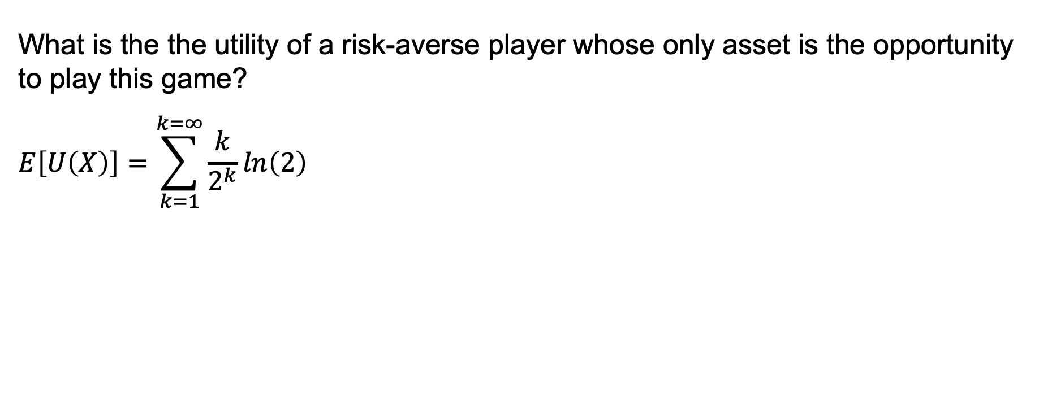
The St. Petersburg game
What is the the utility of a risk-averse player whose only asset is the opportunity to play this game?
$$E\left[U\left(X\right)\right]=\sum_{k=1}^{k=∞}{\frac{k}{2^{k}}ln\left(2\right)}$$

Slide 51
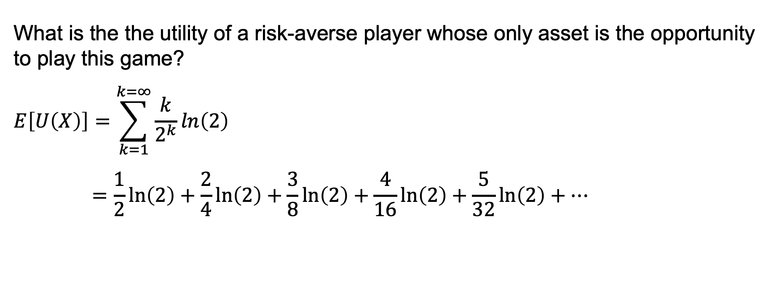
The St. Petersburg game
What is the the utility of a risk-averse player whose only asset is the opportunity to play this game?
$$E\left[U\left(X\right)\right]=\sum_{k=1}^{k=∞}{\frac{k}{2^{k}}ln\left(2\right)}$$
$$=\frac{1}{2}ln\left(2\right)+\frac{2}{4}ln\left(2\right)+\frac{3}{8}ln\left(2\right)+\frac{4}{16}ln\left(2\right)+\frac{5}{32}ln\left(2\right)+…$$

Slide 52
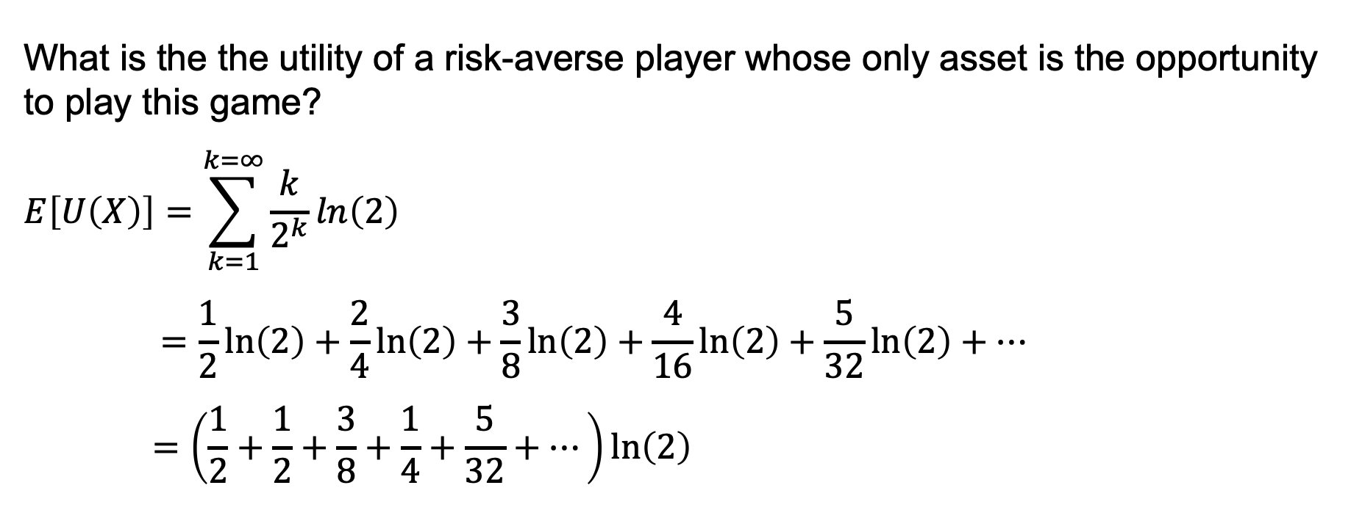
The St. Petersburg game
What is the the utility of a risk-averse player whose only asset is the opportunity to play this game?
$$E\left[U\left(X\right)\right]=\sum_{k=1}^{k=∞}{\frac{k}{2^{k}}ln\left(2\right)}$$
$$=\frac{1}{2}ln\left(2\right)+\frac{2}{4}ln\left(2\right)+\frac{3}{8}ln\left(2\right)+\frac{4}{16}ln\left(2\right)+\frac{5}{32}ln\left(2\right)+…$$
$$=\left(\frac{1}{2}+\frac{1}{2}+\frac{3}{8}+\frac{1}{4}+\frac{5}{32}+…\right)ln\left(2\right)$$

Slide 53
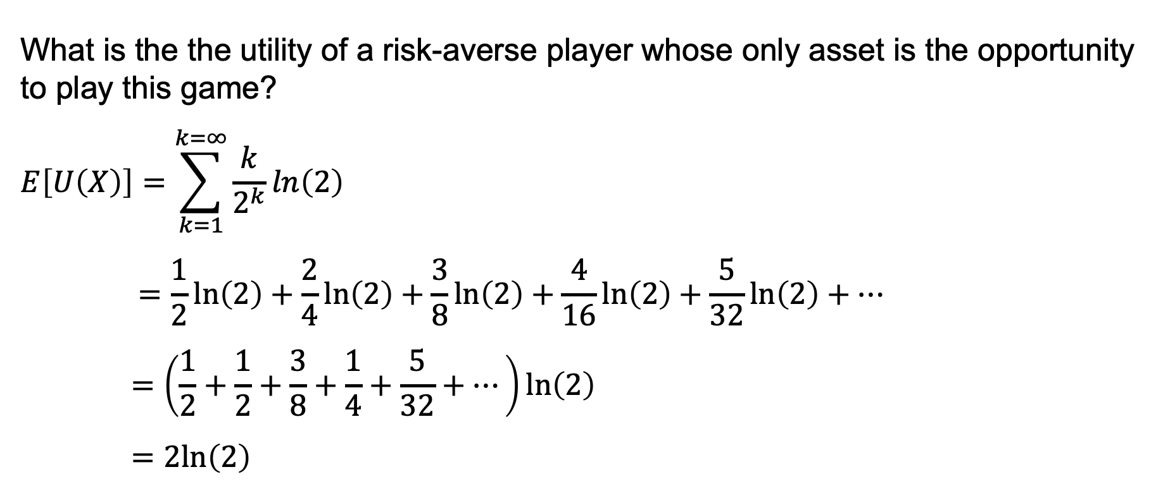
The St. Petersburg game
What is the the utility of a risk-averse player whose only asset is the opportunity to play this game?
$$E\left[U\left(X\right)\right]=\sum_{k=1}^{k=∞}{\frac{k}{2^{k}}ln\left(2\right)}$$
$$=\frac{1}{2}ln\left(2\right)+\frac{2}{4}ln\left(2\right)+\frac{3}{8}ln\left(2\right)+\frac{4}{16}ln\left(2\right)+\frac{5}{32}ln\left(2\right)+…$$
$$=\left(\frac{1}{2}+\frac{1}{2}+\frac{3}{8}+\frac{1}{4}+\frac{5}{32}+…\right)ln\left(2\right)$$
$$=2ln\left(2\right)$$

Slide 54
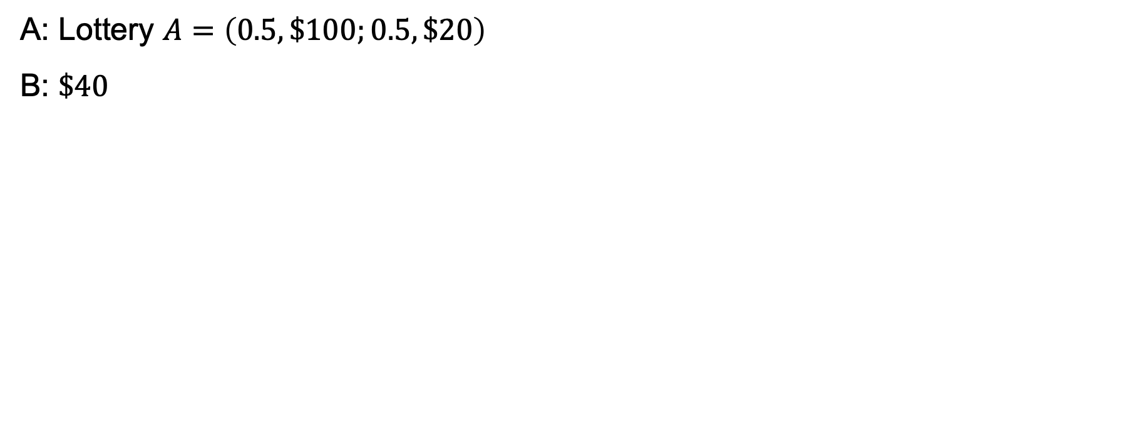
Risk neutrality versus risk aversion
A: Lottery $A=\left(0.5, \$100;0.5, \$20\right)$
B: $\$40$

Slide 55
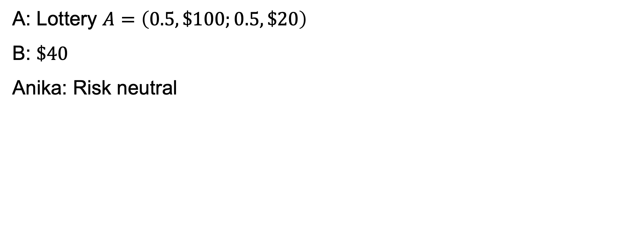
Risk neutrality versus risk aversion
A: Lottery $A=\left(0.5, \$100;0.5, \$20\right)$
B: $\$40$
Anika: Risk neutral

Slide 56
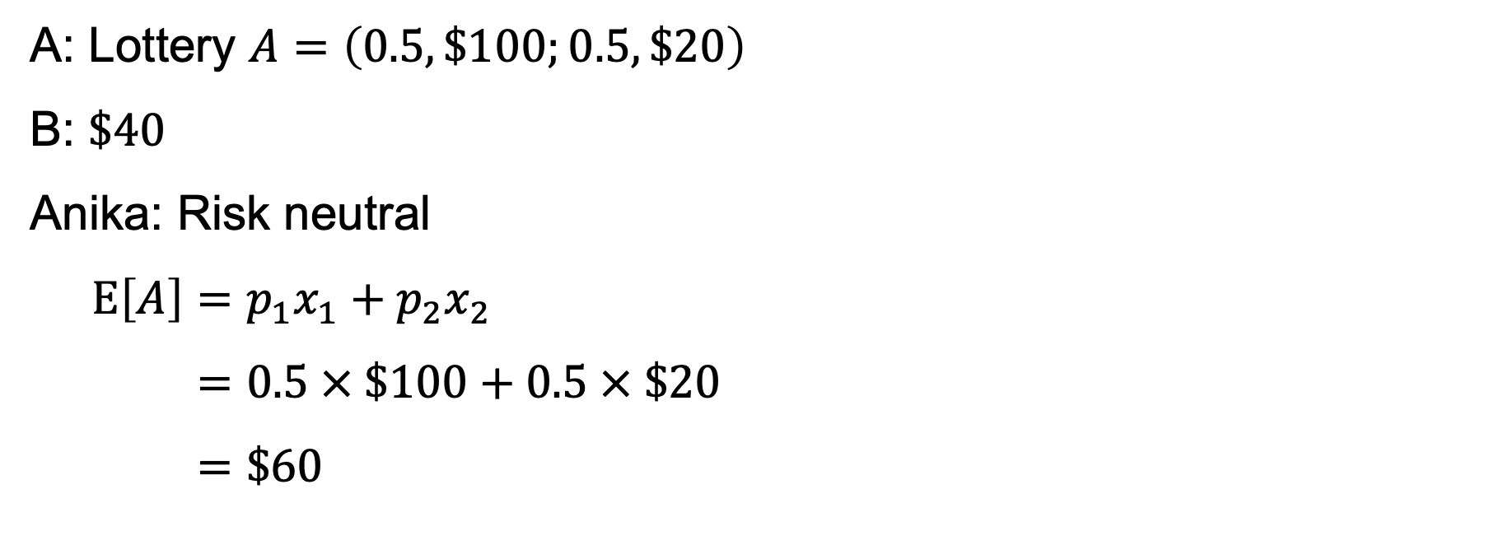
Risk neutrality versus risk aversion
A: Lottery $A=\left(0.5, \$100;0.5, \$20\right)$
B: $\$40$
Anika: Risk neutral
$$E\left[A\right]=p_{1}x_{1}+p_{2}x_{2}$$
$$=0.5 × \$100+0.5 × \$20$$
$$=\$60$$

Slide 57
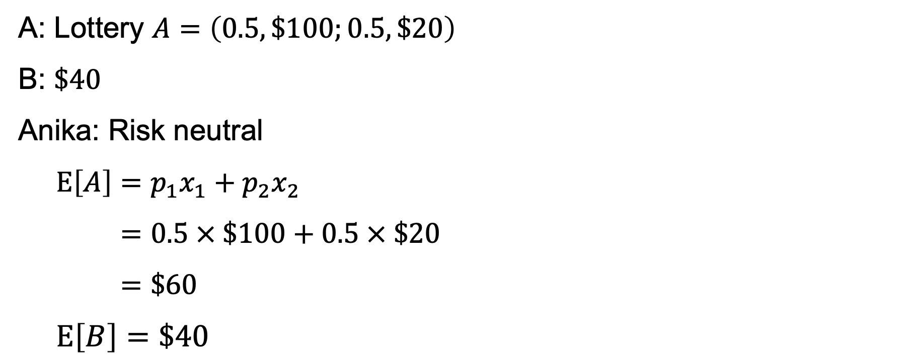
Risk neutrality versus risk aversion
A: Lottery $A=\left(0.5, \$100;0.5, \$20\right)$
B: $\$40$
Anika: Risk neutral
$$E\left[A\right]=p_{1}x_{1}+p_{2}x_{2}$$
$$=0.5 × \$100+0.5 × \$20$$
$$=\$60$$
$$E\left[B\right]=\$40$$

Slide 58

Risk neutrality versus risk aversion
A: Lottery $A=\left(0.5, \$100;0.5, \$20\right)$
B: $\$40$
Anthony: Risk averse with wealth $100; $U\left(x\right)=ln⁡(x)$

